Slide 1






Welcome
The ADAC Program Year 8 Annual Meeting will start at
8:00 AM AKDT/
12:00 PM EDT
ADAC: Research for the Arctic Operator… For Today and For the Future

Slide 2



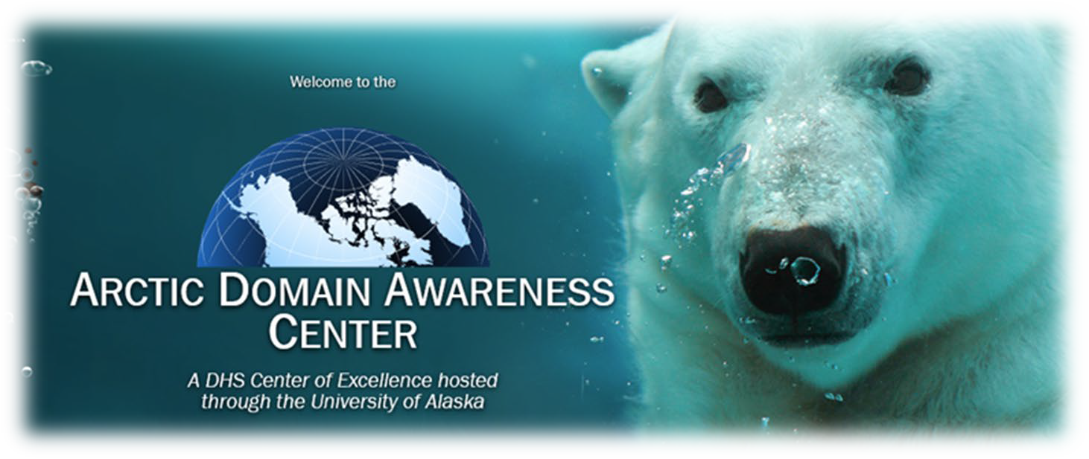
Welcome to ADAC’s Program Year 8 Virtual Annual Meeting 20-21 April 2022
Arctic Domain Awareness Center University of Alaska
ADAC: Research for the Arctic Operator… For Today and For the Future
ADAC: Research for the Arctic Operator… For Today and For the Future

Slide 3

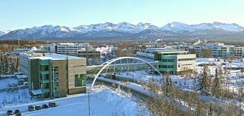
An opening welcome from UAA Chancellor Sean Parnell
ADAC Year 8 Annual Meeting, 20-21 April
Chancellor Sean Parnell, Former Alaska Governor,
University of Alaska Anchorage
ADAC: Research for the Arctic Operator… For Today and For the Future

Slide 4

Please Welcome our DHS Introductory Speaker,
Wallicia Tapscott
ADAC Year 8 Annual Meeting, 20-21 April
Wallicia Tapscott, DHS S&T Office of Innovation and Collaboration, Principal Director
ADAC: Research for the Arctic Operator… For Today and For the Future

Slide 5
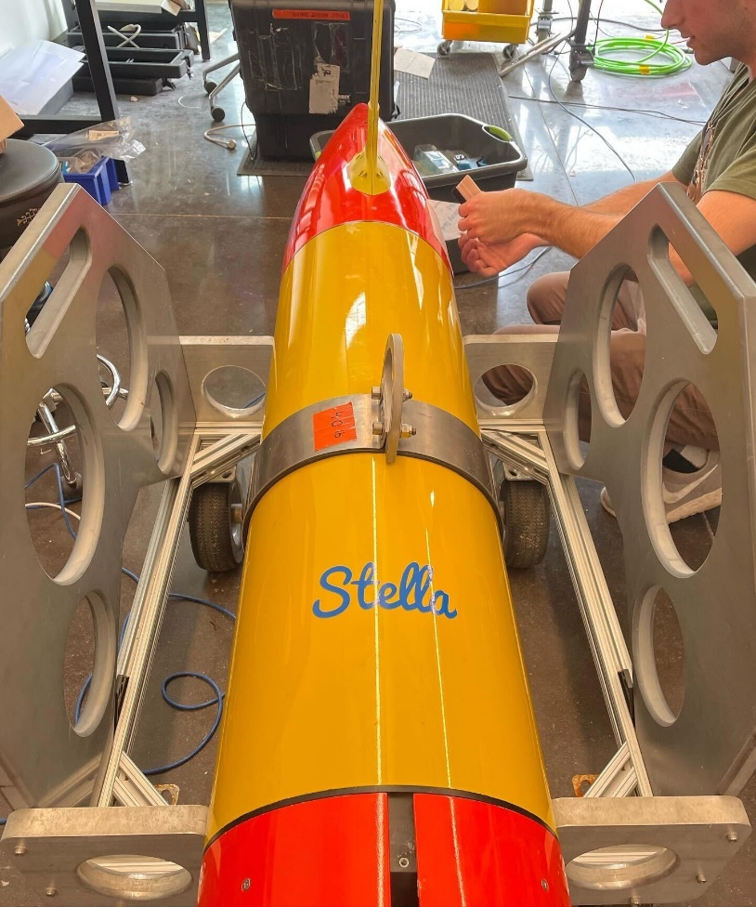
ADAC Year 8 Annual Meeting
April 2022
ADAC Project Briefing
(LRAUV) for Under-Ice Mapping of Oil Spills and Environmental Hazards
PI Amy Kukulya (WHOI)
PI Brett Hobson (MBARI)
and Noa Yoder (WHOI, presenter)

Slide 6
ADAC Year 8 Annual Meeting
April 2022
ADAC Project Briefing
(LRAUV) for Under-Ice Mapping of Oil Spills and Environmental Hazards
PI Amy Kukulya (WHOI)
PI Brett Hobson (MBARI)
and Noa Yoder (WHOI, presenter)

Slide 7
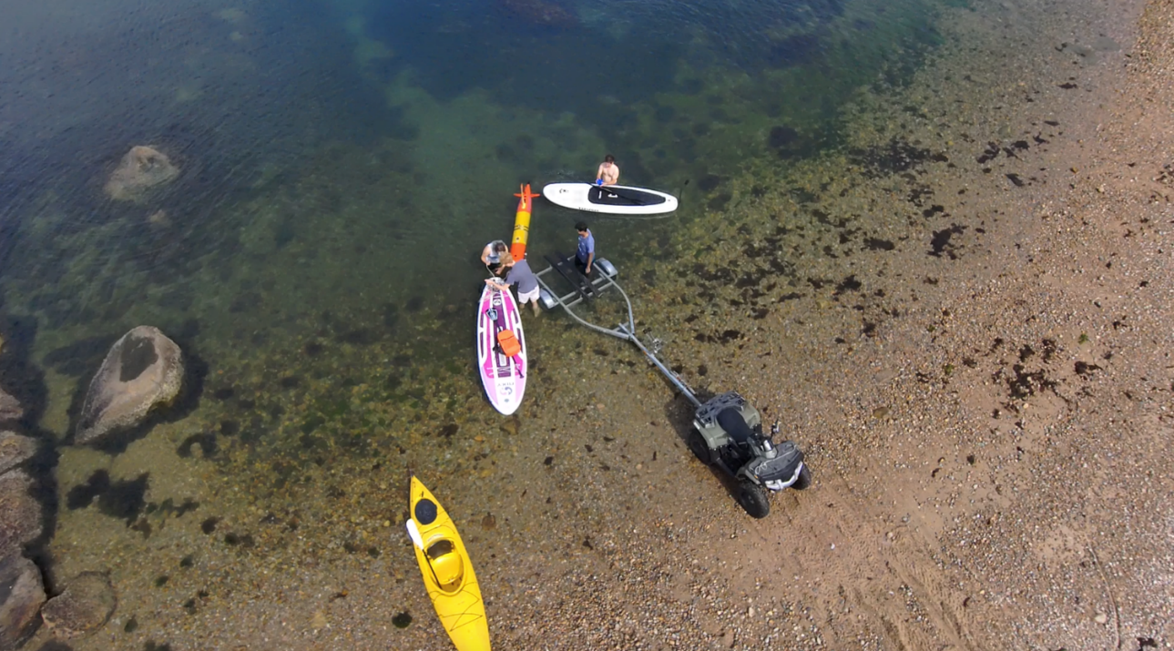
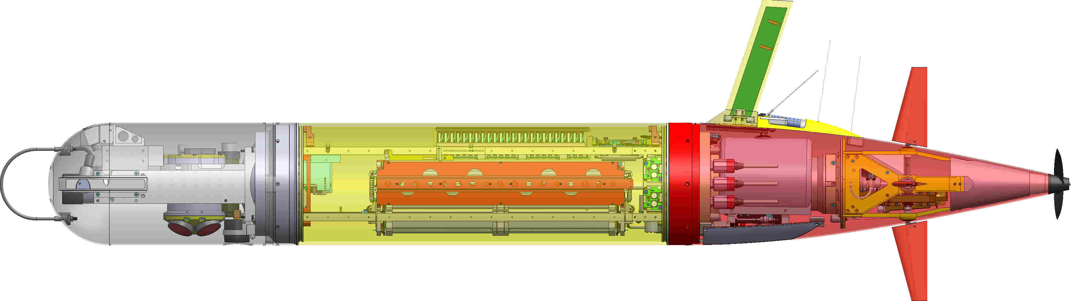
ADAC Project (LRAUV) for Under-Ice Mapping of Oil Spills and Environmental Hazards
Project Principal Investigator(s): PI/PM Amy Kukulya (WHOI), Co-PI Brett Hobson (MBARI)
Woods Hole Oceanographic Institution, Monterey Bay Aquarium Research Institute
Supporting Team: Daniel Gomez-Ibanez, Noa Yoder, Amanda Besaw, Brian Kieft, Ben Raanan, Ryan Govostes, Steven Seeberger, Kaitlyn Tradd, Adarsh Salagame, Aidan Kenny, Cameron Fairclough
Project Champion: Kirsten Trego, HQ USCG MER
Project Advocates: Dr. Robyn Conmy, EPA USEPA/NRMRL/RTEB, USCG Research and Development Center, Dr. Jay Choy BSEE/Oil Spill Preparedness Division, Dr. Lisa Dipinto, NOAA, Office of Restoration and Response, Mr. Brian Dolph, USCG R&D Center

Slide 8
LRAUV: Description and Baseline
Baseline: Currently, there is no USCG baseline for an AUV to meet the unique demands of Arctic operations that requires a minimal logistical footprint, a small operational team and oil detection and mapping capability.
Project Description: To develop an Arctic-capable long-range Autonomous Underwater Vehicle (AUV) that is helicopter portable, carries an environmental mapping payload, allowing rapid response while providing situational awareness and damage mitigation for first responders/USCG.

Slide 9
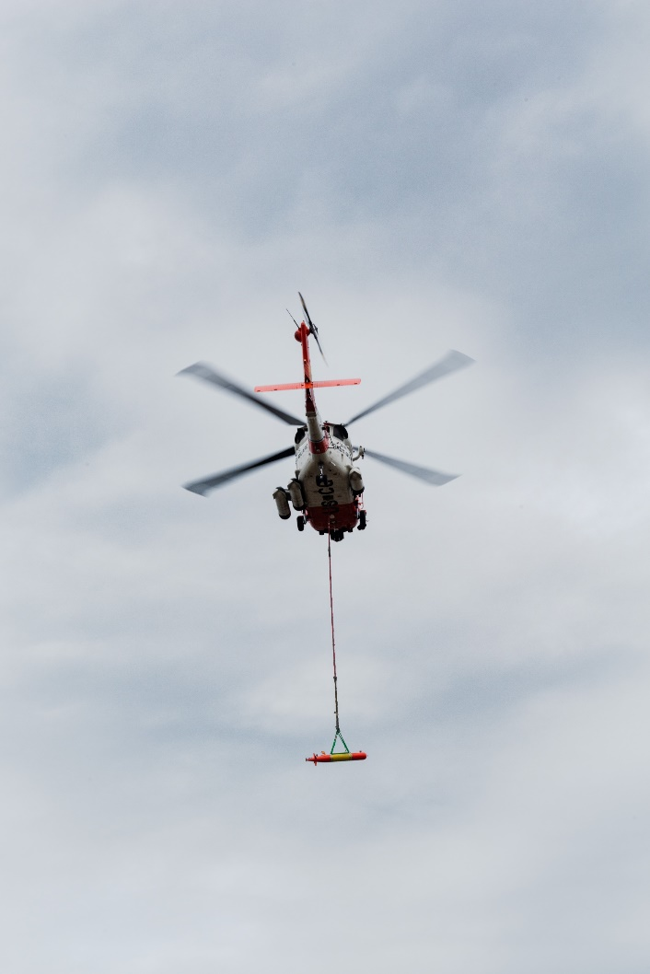
Project LRAUV Relevance and Method
Relevance to DHS and USCG: We characterize the challenge as the ‘last seat in the helicopter’ problem: If first responders are operating at the far end of their logistical support capability, the system must be able to fill that void.
Research Method: Our approach leveraged an existing base Long-Range AUV developed at MBARI (LRAUV), and enhance the system to detect oil and operate under ice. LRAUV offers extended ranges (one to three weeks), and can be operated by a team remotely and monitored by anyone, anywhere.
  Next up:
    Prior (where you have been)
    Current (where you are at)
    Projected (where you want to go)

Slide 10
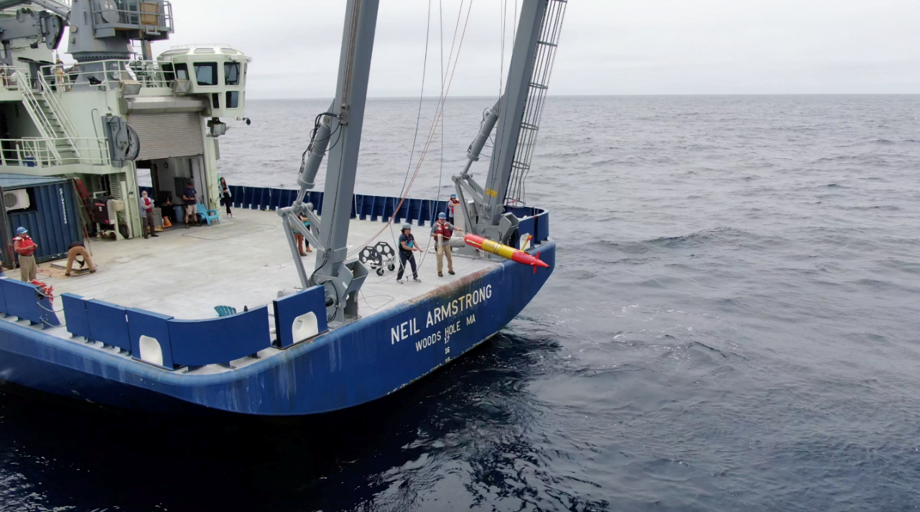
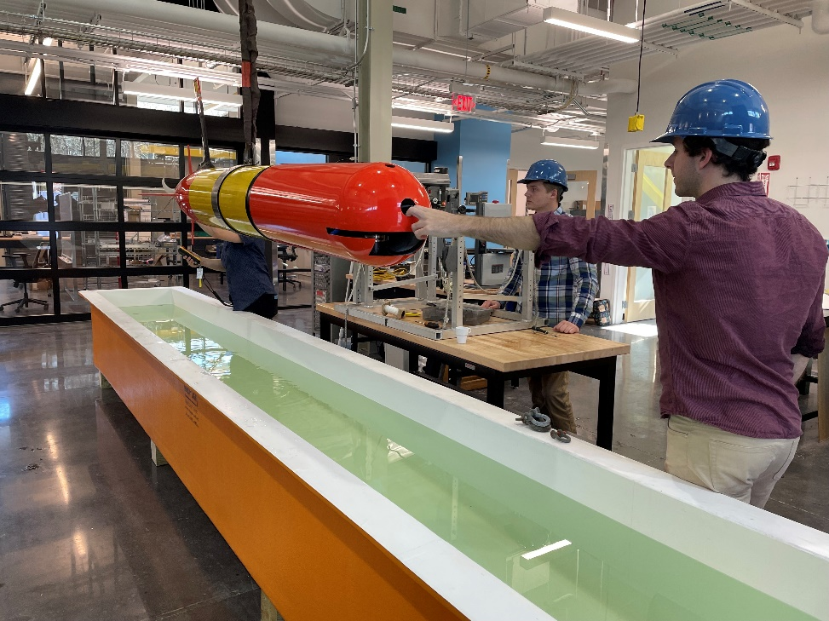
ADAC LRAUV Updates
Backseat- wireless joystick driving (Co-op project)
  Now works over cell for longer range
  Backseat- Sidecar Action Manager development, allowing sensors and behaviors to be developed in a vehicle agnostic way so capabilities can be leveraged across platforms (students, software engineers)
LRAUV backseat computer system health monitor ROS node
LRAUV Software Simulation
  Hardware in the loop to test things like oil spill simulations
  Currently set up with Burger Oil field Simulation
  Lab tests are successful and now needs open water testing for Arctic demo preparation

Slide 11
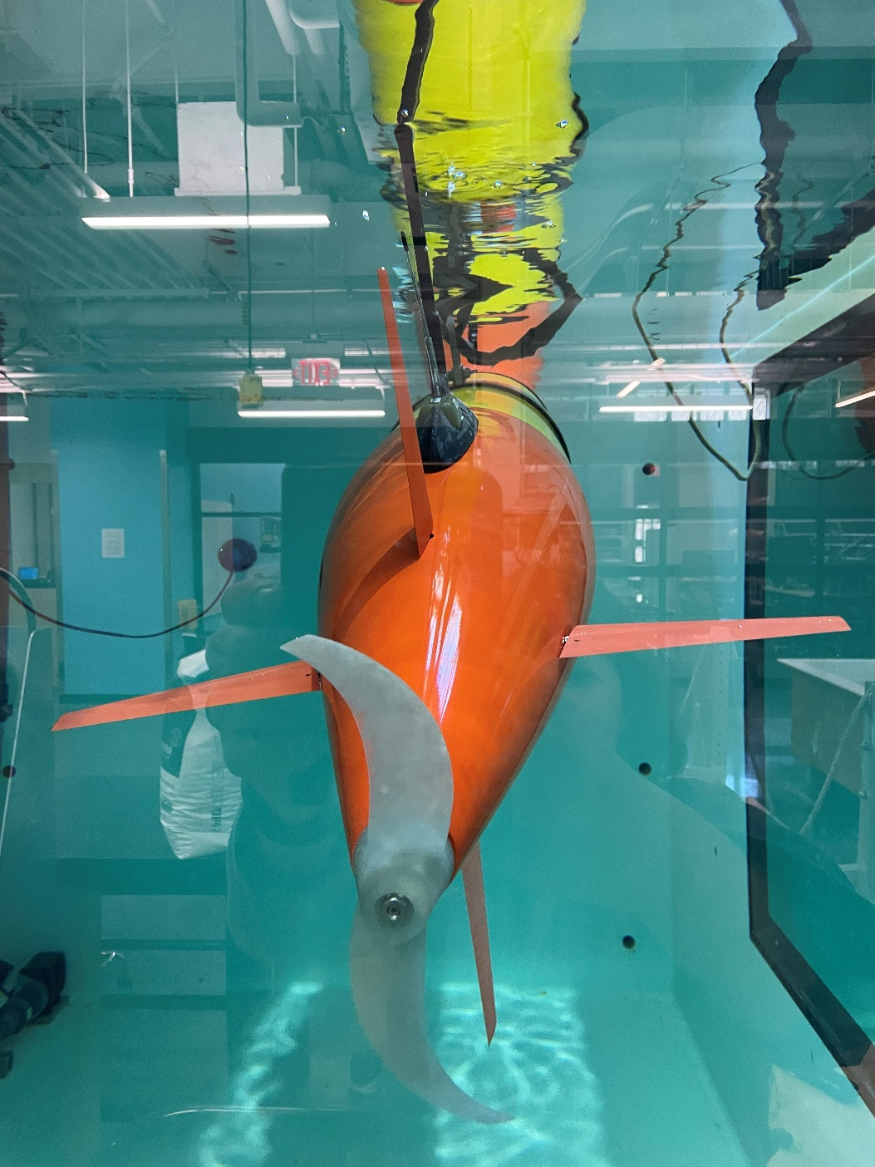
LRAUV Updates:
  Ran 3 over-the–horizon missions.
  Completed 450 km mission offshore (shipless) X 2
  Conducted two virtual Stakeholder training sessions
  Developed new software behavior missions (>20) for docking, undocking, no surfacing, new sensor configurations
  Provisional Patent

Slide 12
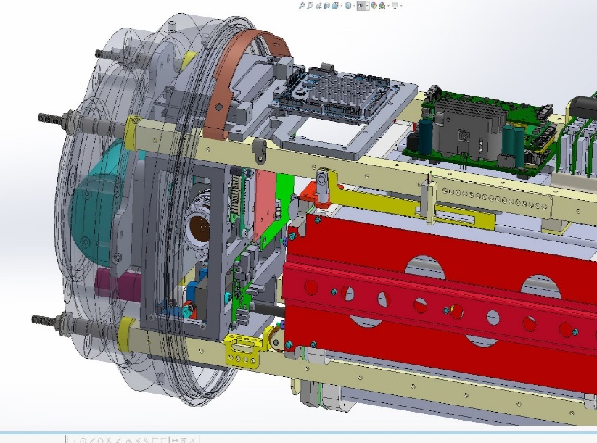
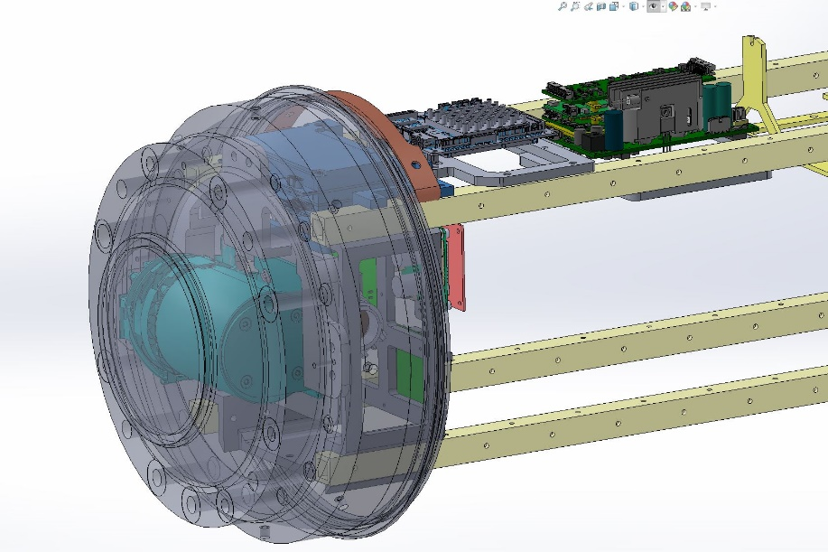
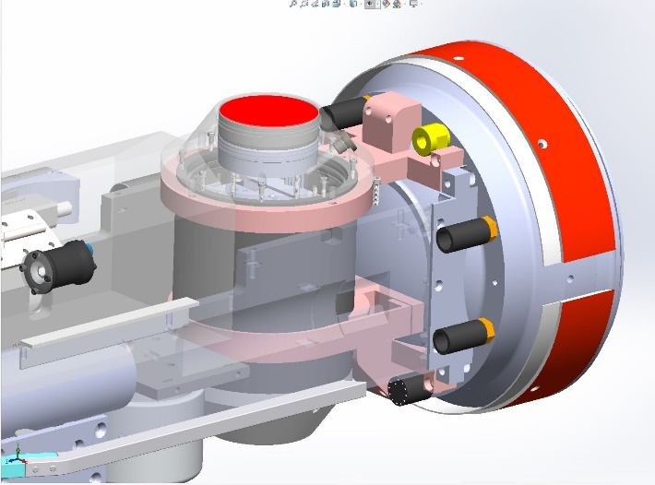
Where we are at:
  Developed LBL (filter updates implemented)
  Integrated multibeam on Stella
  Completed Stella Build!
  Refined docking (extreme cold tolerant gearbox installed and tested successfully)
  Developed onboard sim mission for plume tracking tests
  Updated plume tracking algorithm (MBARI testing)
    Burger Oil field Sim tested on vehicle in lab
  Built second docking nose (for Stella)
  Working on software for GPS, time, timing (1 PPS), for IMU and sonar, new PIC board- Completed and bench testing
  All updated wiring for new sensors and config complete
  Built vehicle in a box, Proxima (for rapid testing)

Slide 13
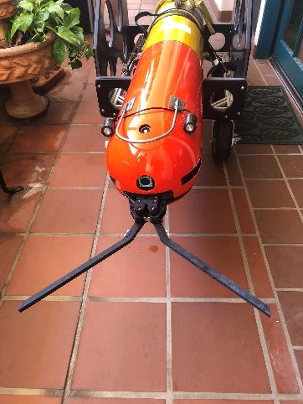
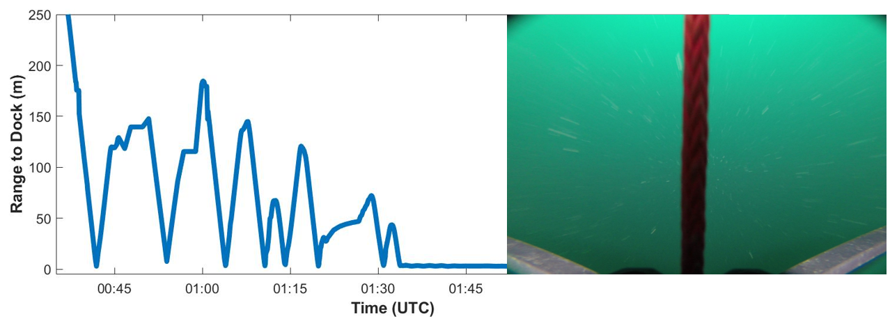
Polaris Applications
DOCKING Payload Completed
Polaris homes to the Acoustic Gateway Buoy using a USBL. Then it uses the Dynamic Docking Module (pictured left) to hook and latch onto the buoy anchorline. This conserves energy while awaiting new missions or recovery.

Slide 14
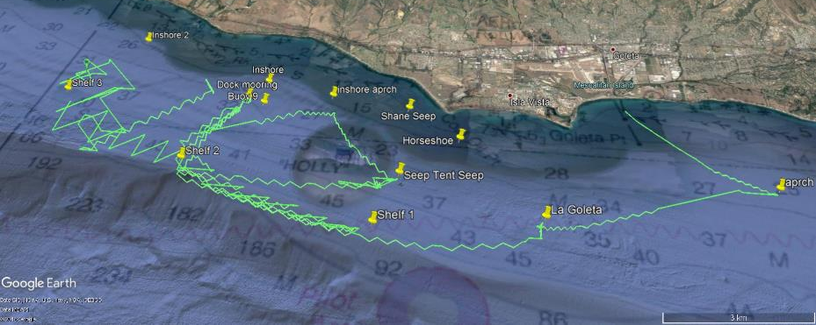
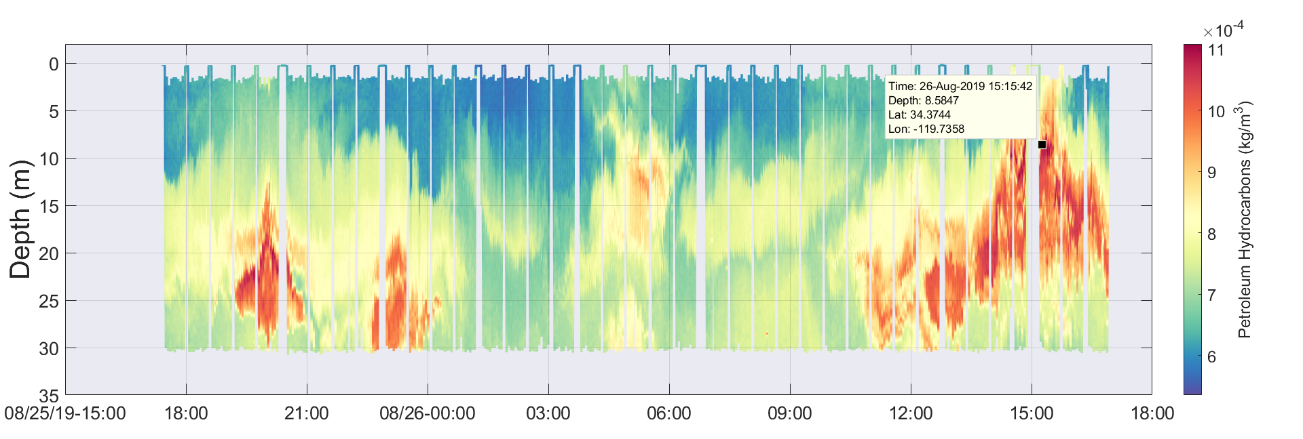
Polaris Applications
Oil Spill Mapping
Polaris uses the SeaOwl UV-A sensor to detect dissolved petroleum hydrocarbons in the water using optical backscatter.

Slide 15
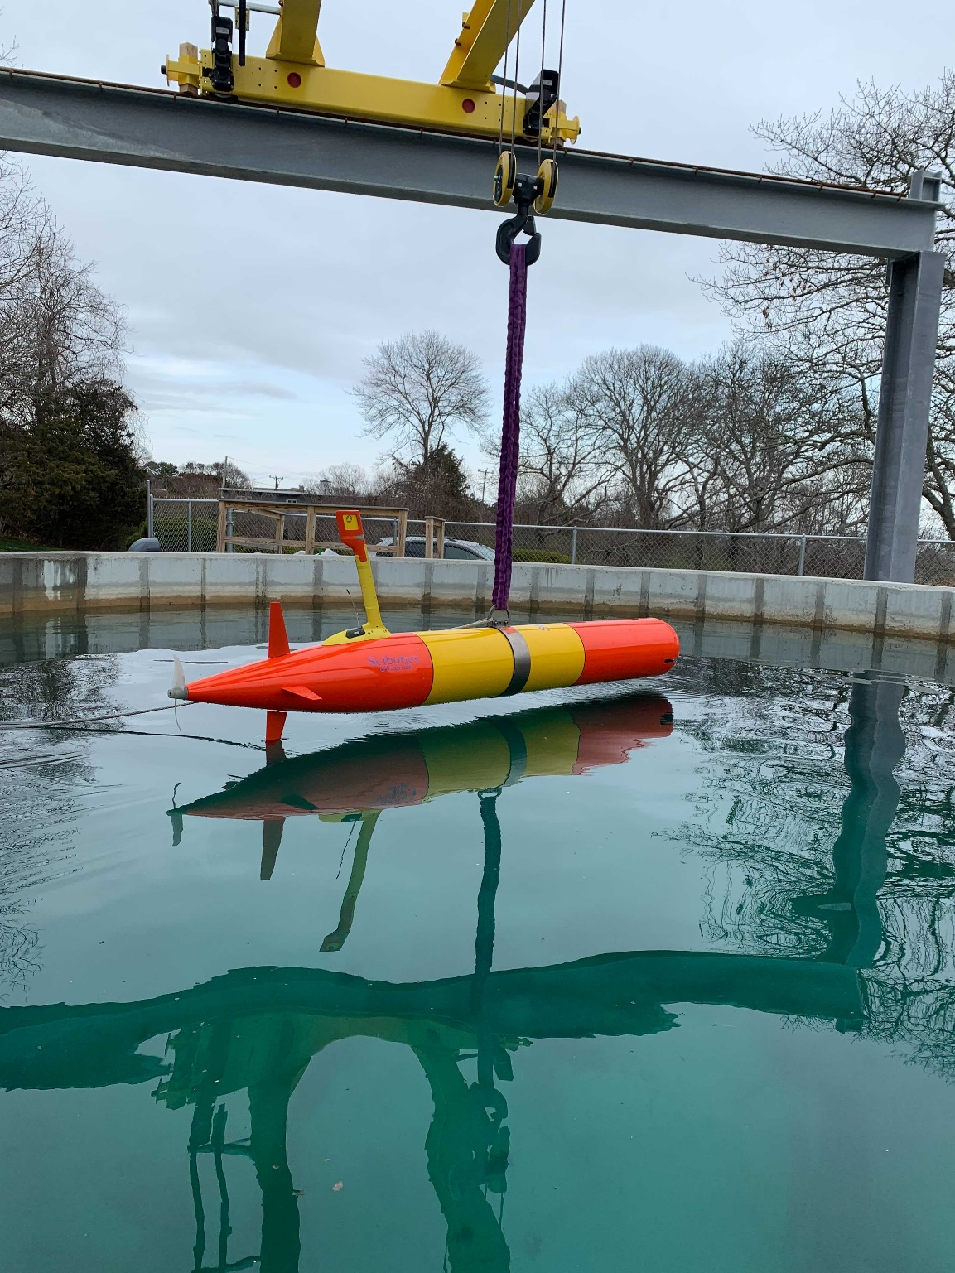
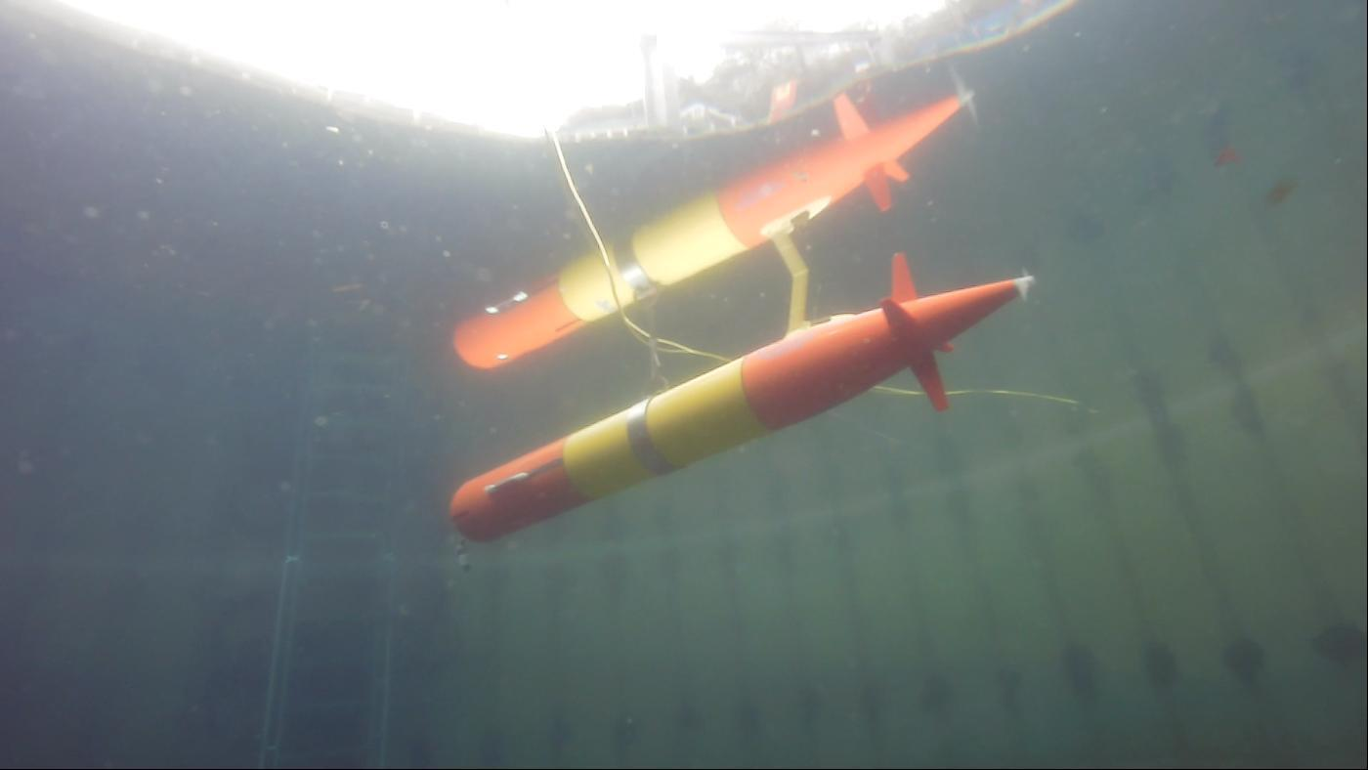
Introducing STELLA!

Slide 16
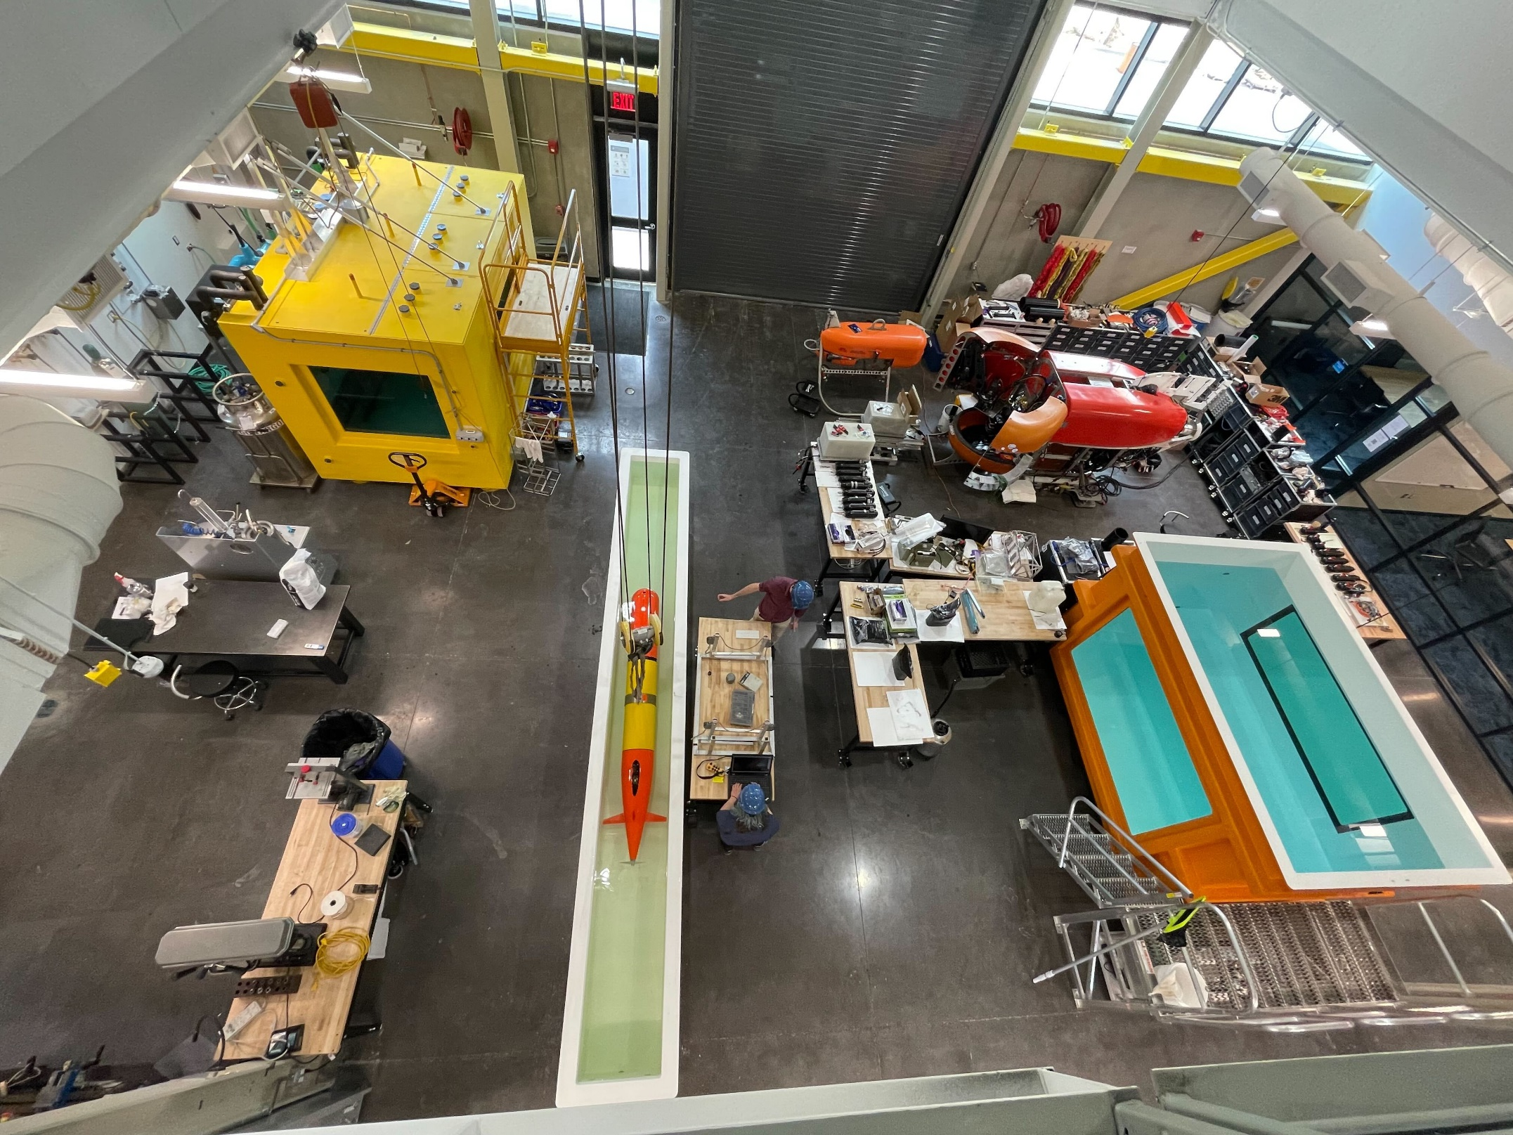
The WHOI Scibotics Team leveraged WHOI’s Innovation Center to build, integrate and test sensors and Stella with lots of MBARI synergistic collaboration

Slide 17
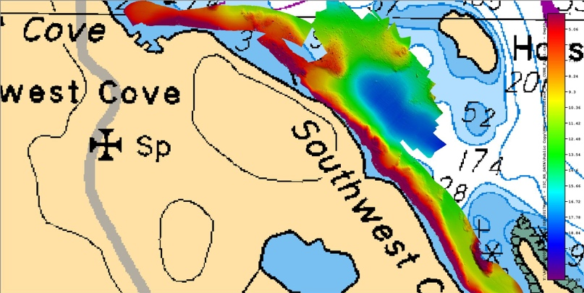
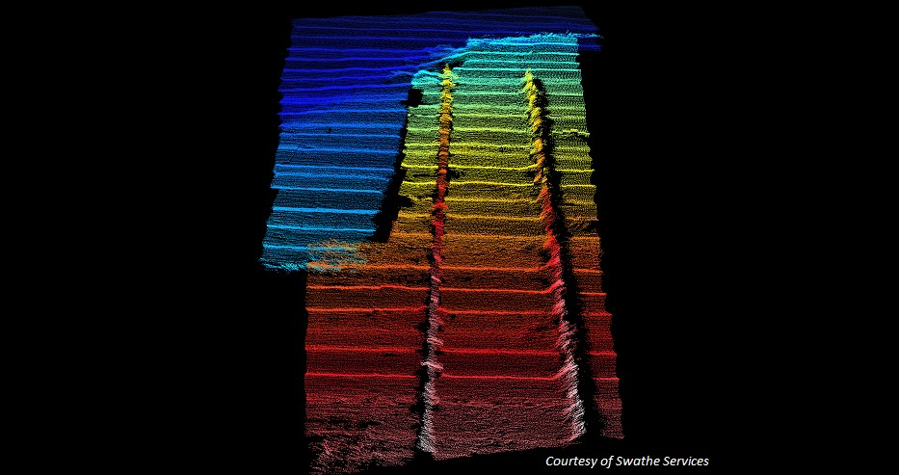
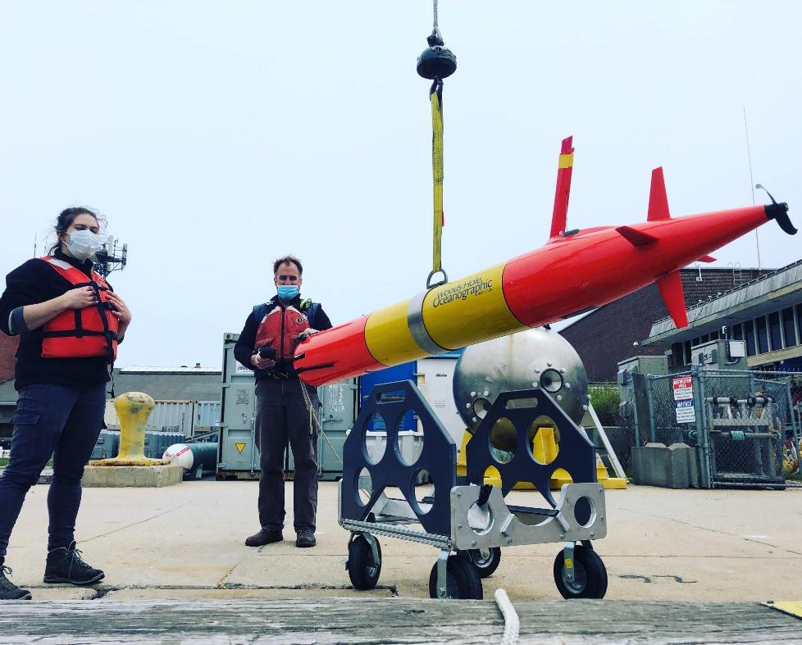
Polaris & Stella have interchangeability
Multi-mission capability
Seafloor mapping
Bathy charts
Shipwreck search/map
Under-ice and glacier mapping
Under-ice and in water oil/gas detection
Notes:
Adding payloads and multi-mission capability
Norbit 400kHz (Frequency Agility 200-700kHz) WBMS Bathymetric System
integrated with Real-time Sonar Head Sound Velocity Sensor. Includes
Snippets, Sidescan, Backscatter and Water Column Output. Includes Sonar
Interface Unit (SIU-I)

Slide 18
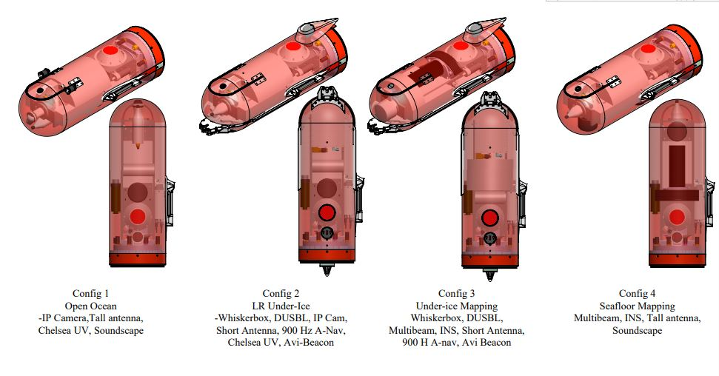
Where we are going:
  Two LRAUV vehicles with four nose configurations:
    Open water science standard sensors, tall antenna, Chelsea UV, Soundscape
    LR under-ice with Whiskerbox, DUSBL, short antenna, Chelsea UV, Avi-beacon with room for camera, 900 Hz A-Nav
    Under-ice mapping, Whiskerbox, DUSBL, Multibeam, INS, short antenna, 900 Hz A-Nav, Avi Beacon
    Seafloor mapping, Multibeam, INS, tall antenna, soundscape

Slide 19

ADAC LRAUV Updates
Leveraged funding from NSF project to develop and test 2D front tracking algorithm
Choose your Proxy
Illustration of the AUV’s horizontal zigzag tracks alternating in westward and eastward sweeps between a western bound and an eastern bound. Over the duration of the sweeps, the front moved southward. On every instance of front detection, the vehicle continues flight for a prescribed distance (marked green), and then turns an oblique angle to fly back to the other water column. When the AUV reaches the western bound, it reverses course.
In one mission on 25 June 2021, LRAUV Polaris detected and passed through the salinity-intrusion front five times. Front detection on each transect is shown in Fig. 8, with corresponding transect numbers.
Snapshot from LRAUV camera capturing squid in a salt intrusion
(Figures courtesy of Yanwu Zhang, MBARI and not for distribution)

Slide 20
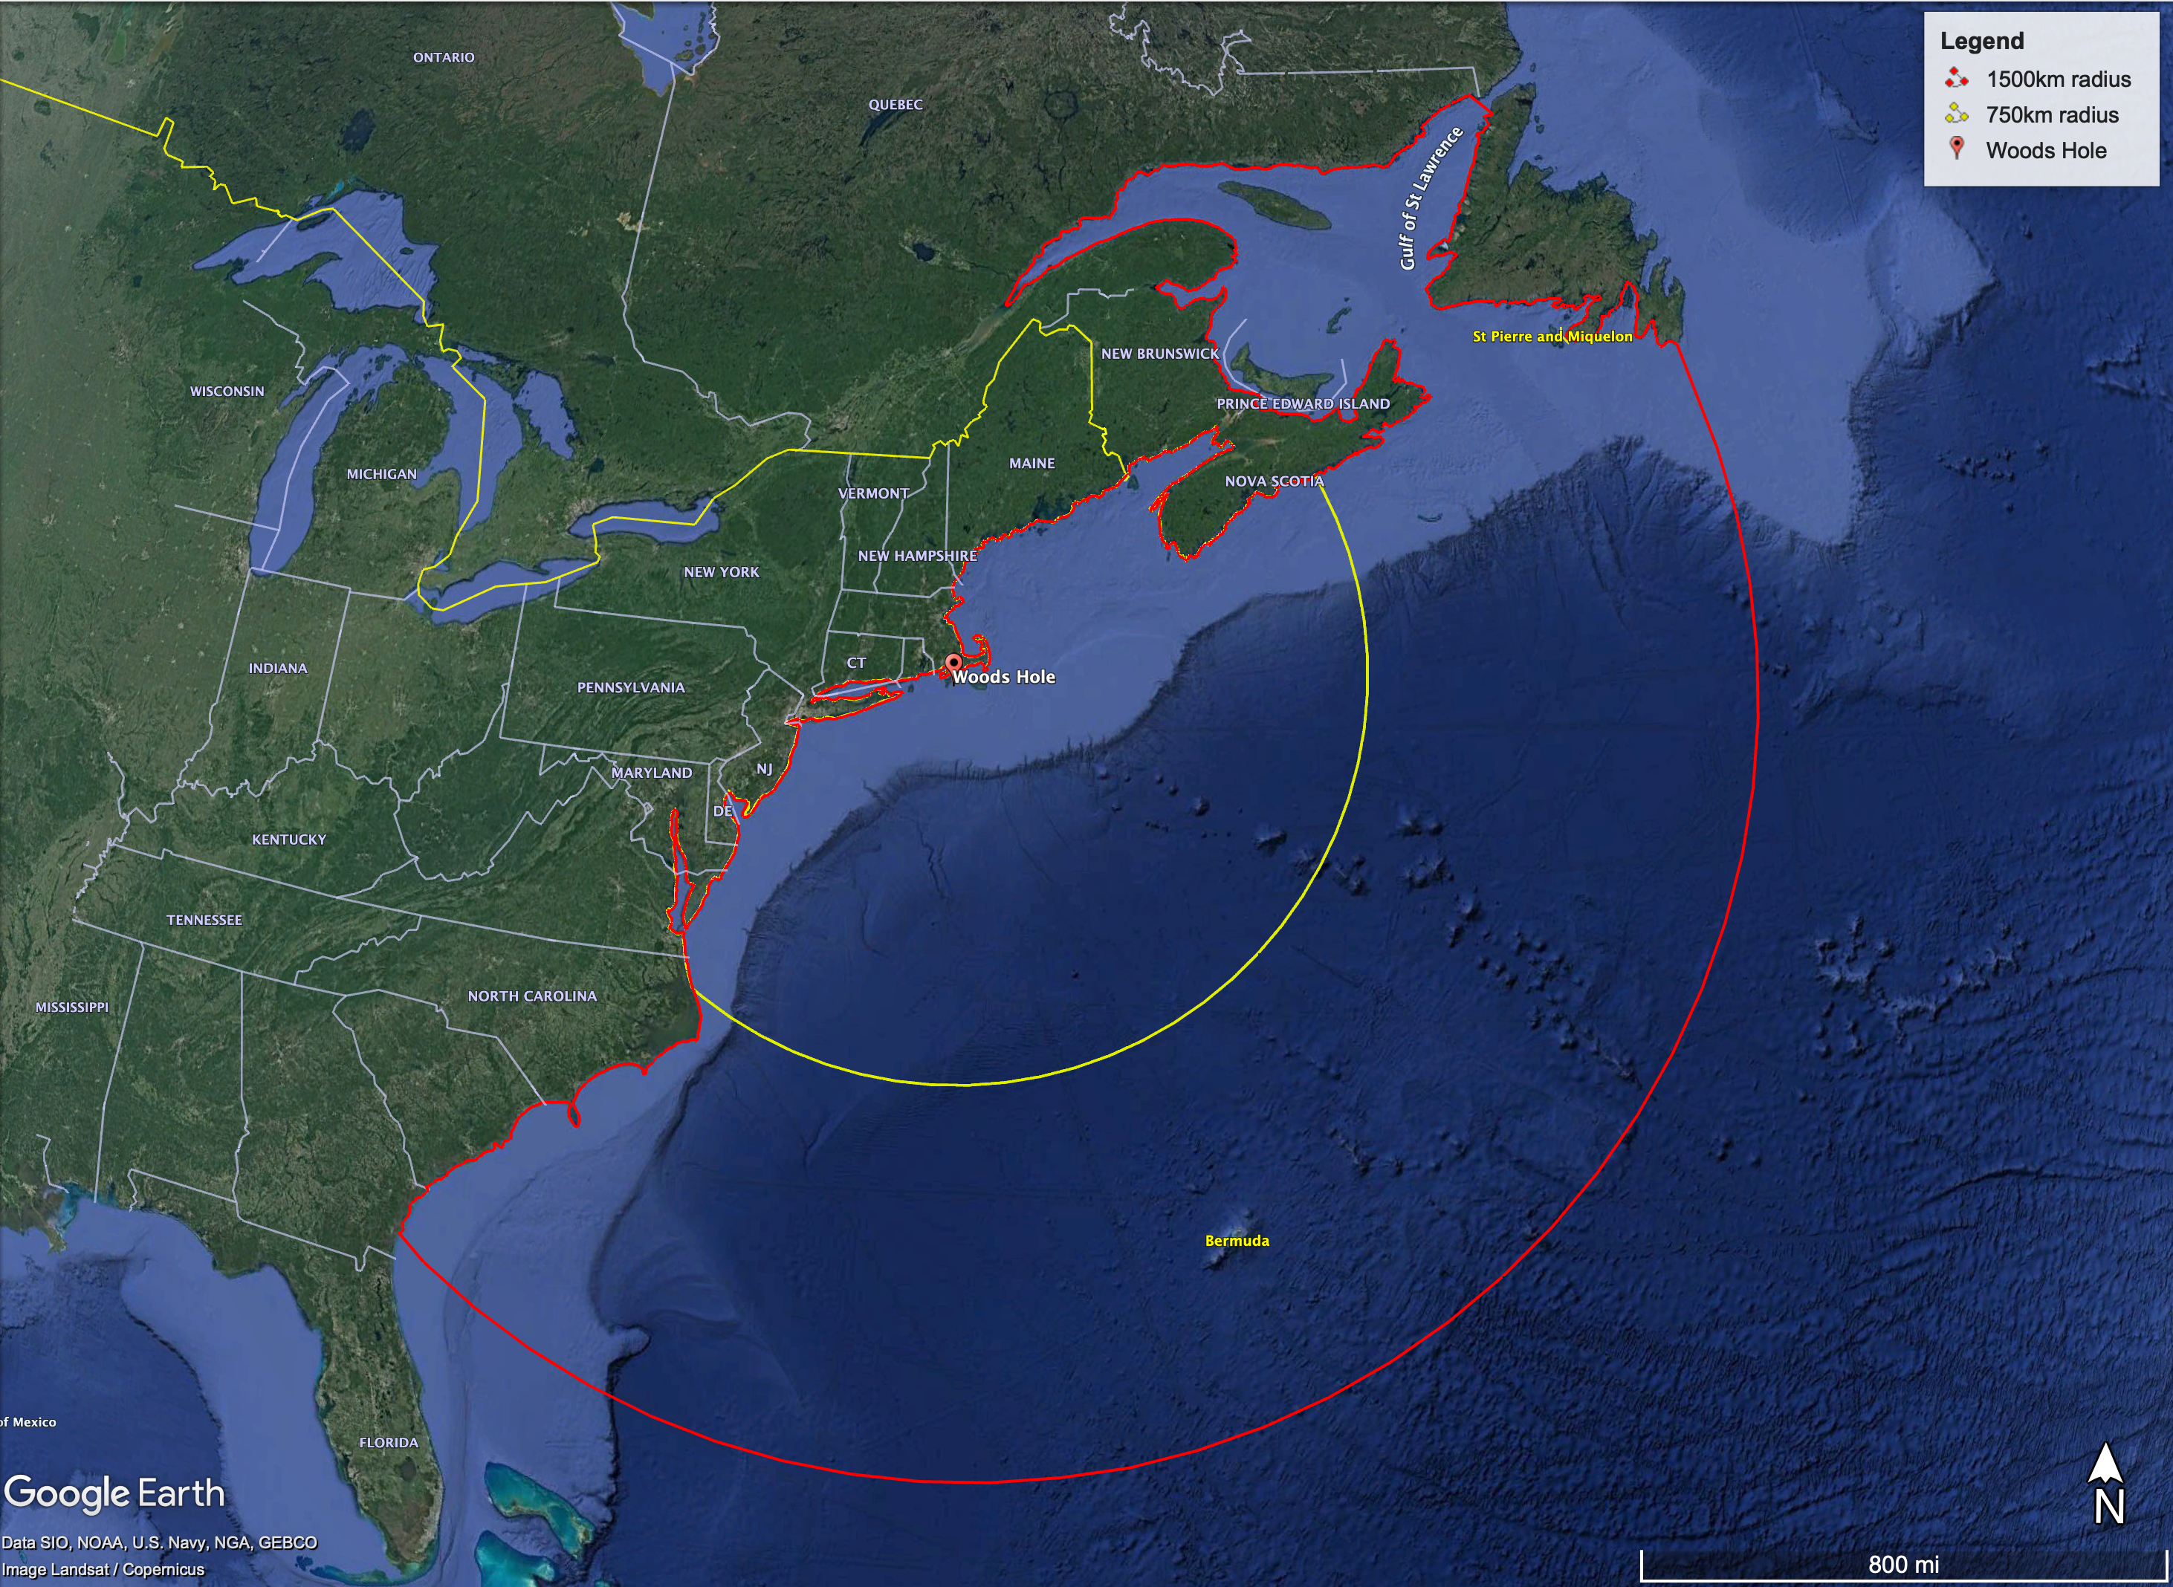
What you can expect:
Bermuda, anyone?

Slide 21
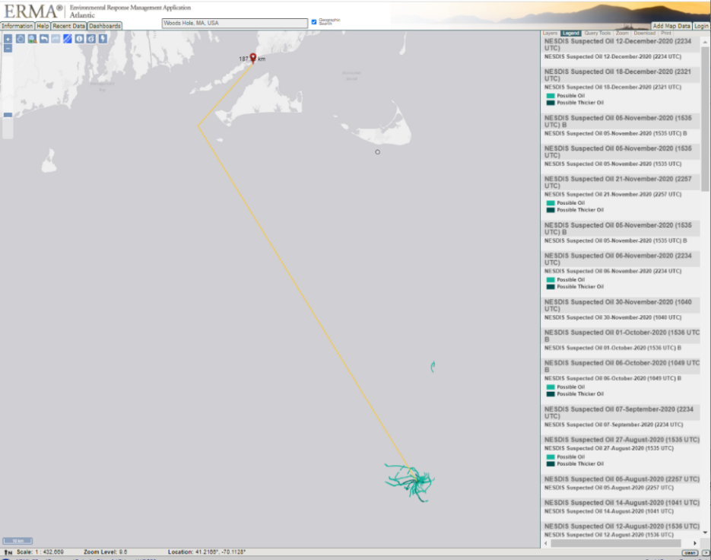
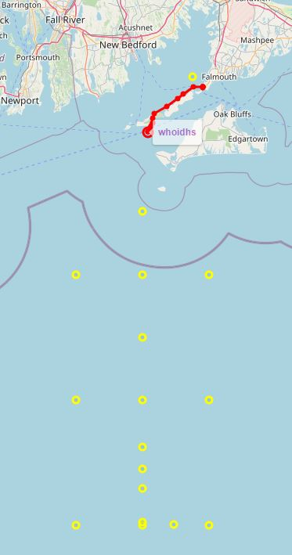
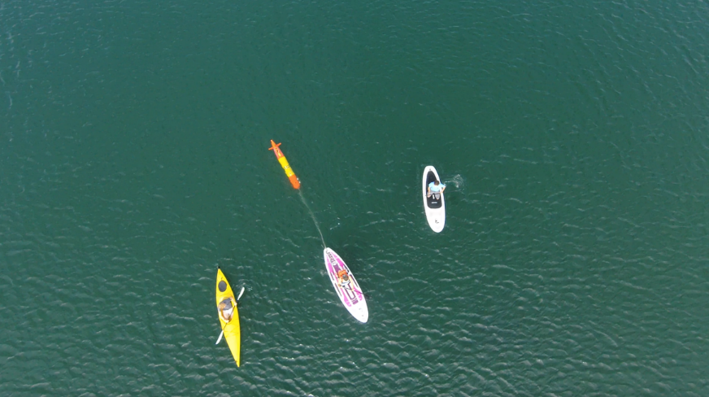
Long-range adds versatility: Wreck 1487
Overview of over-the-horizon mission – Shipless Operations
188 km from Woods Hole shipwreck actively leaking oil….in LRAUV wheelhouse (Scott Lungren (NOAA)

Slide 22
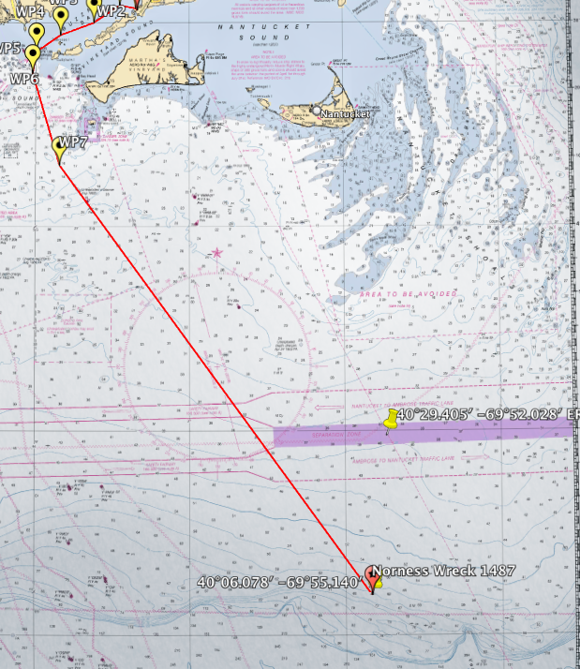
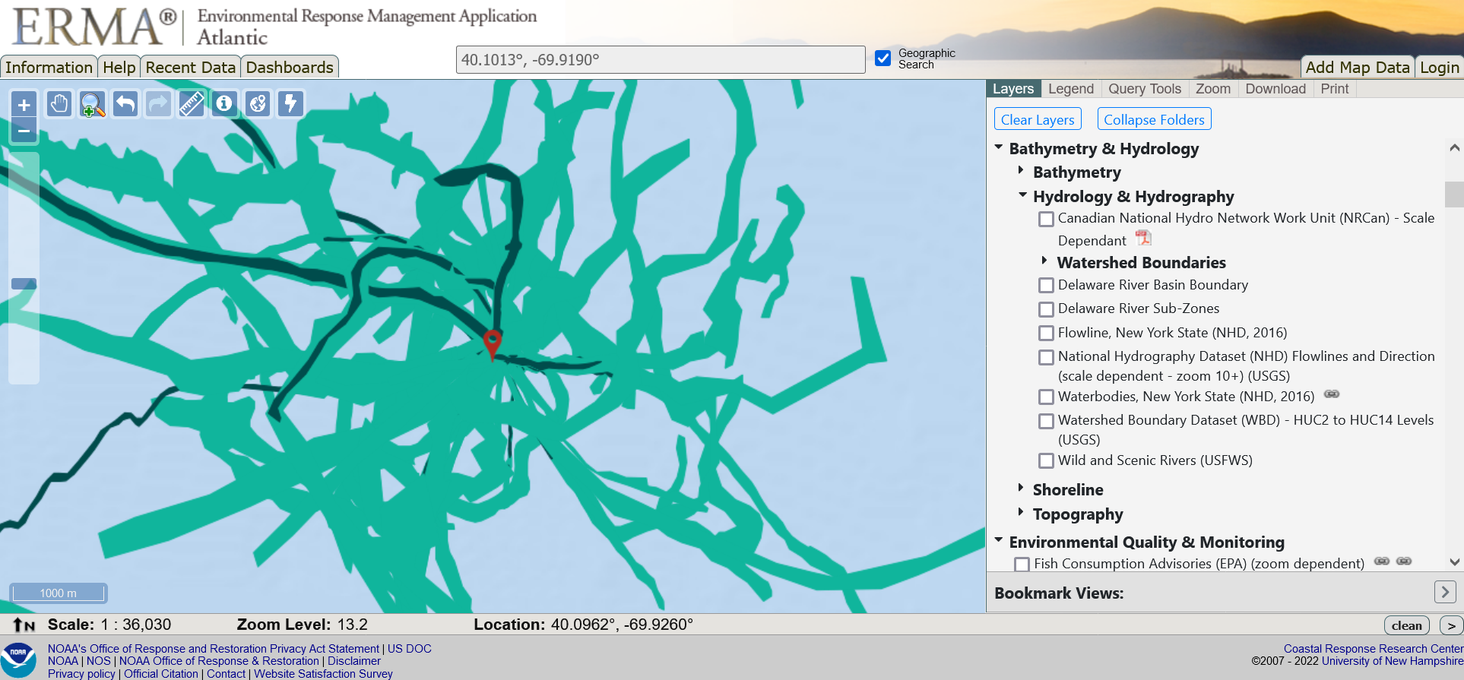
Long-range adds versatility: Wreck 1487
13 day mission out to the shelf break and back with LRAUV
Started out as a find-the-oil mission
A Nor’ester hit the area and we reprogrammed to yo-yo to collect storm impact data on T&S
Notes:
There are 7-8 other wrecks in the area they would love to be surveyed. 11 leaky wrecks in the NE (although the number is growing and now should include the ANDREA DORIA
Sometimes USCG training divers dive on these wrecks but priority is set based on Hurricane Ida impacts currently and unlikely NE wrecks will be practice dives.
On May 20th, 2013, NOAA presented the U.S. Coast Guard a national report that finds 36 sunken vessels scattered across the U.S. seafloor could pose an oil pollution threat to the nation's coastal and marine resources. Of those, 17 were recommended for further assessment and potential removal of both fuel oil and oil cargo.
EEZ wrecks

Slide 23
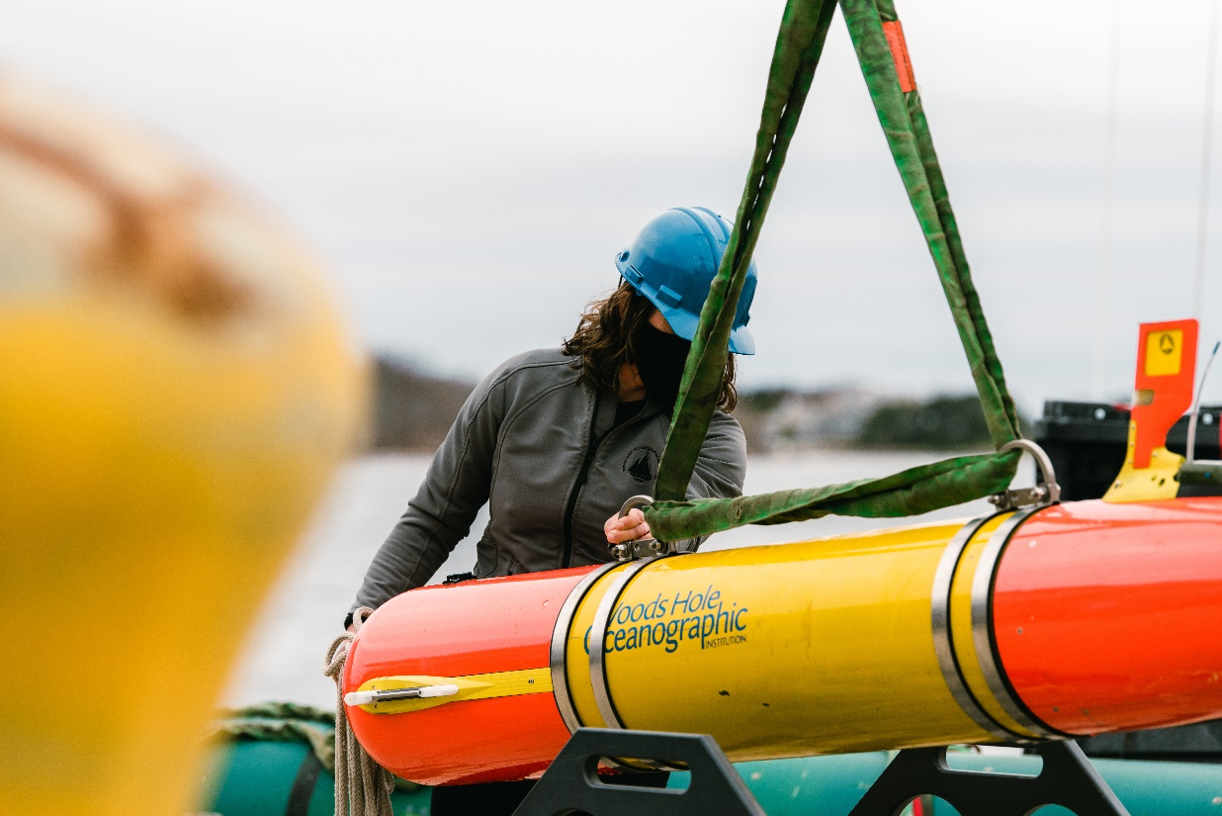
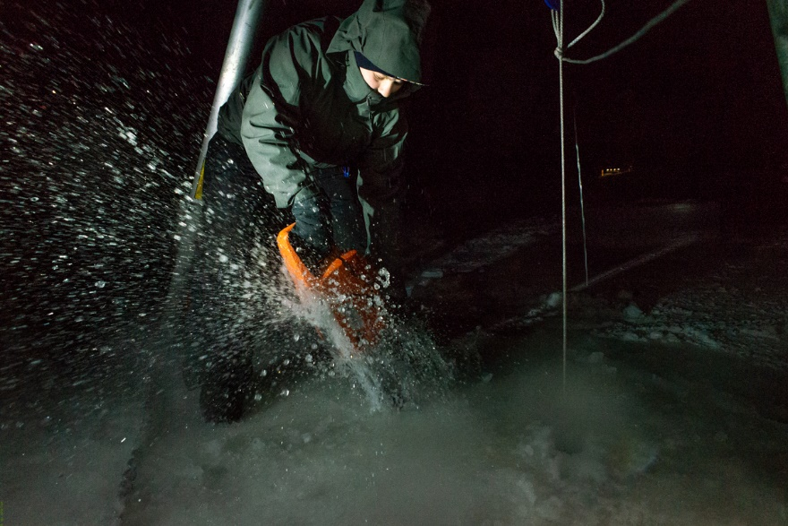
Where we are going: Growing Applications!
  Fly away capability with rapid response for oil spills, sunken ships (etc.), pipe leaks, seafloor mapping, habitat monitoring, measuring soundscapes (weather, whales, etc.), long-range shipless surveys, open ocean, fresh water and under-ice capabilities over-the-horizon data relay, 24/7 operator response
  Center of Expertise
  Go to for help…it’s already happening…USCG, NTSB, NOAA, USGS, Science community…

Slide 24
Project LRAUV: Schedule and Metrics
Fabrication of a second platform (Stella) Conducted Arctic Readiness Testing, over-the-horizon testing, docking and acoustics
  Three buoy system completed- one buoy is HF, two LF
  Docking/Undocking reliability ~60% and a new cold weather gear box has been switched out
  Comms reliability (antenna/buoy/Dash)
Provide training and familiarization of LRAUV to USCG
Develop software for improved operator system interface
  Backseat is integrated, new sensors can be integrated.
  Multibeam is integrated
  Inertial navigation is integrated
  Dash operator Portal is complete at LRAUV.WHOI.EDU and receives monthly updates/improvements

Slide 25
Project LRAUV: Planned Research Outcomes
Planned outcomes of the research:
  A helicopter portable Long Range AUV, for under-ice and over-the-horizon shipless anomaly and oil detection with deployable Arctic buoys for aided navigation, remote communication and docking; around-the-clock expertise available and training with a TRL 6/7 system ready for low-rate manufacturing and payload capability expansion.
Additional research identification:
  Service for hire
  Interest in commercialization
  Interest in scientific community to use and develop tech (BSEE, EPA, NOAA, etc.)
    (more vehicles, deeper ratings, recharge capabilities)

Slide 26
What needs improvement or is missing?
  Sensing of oil against the ice and seafloor and high latitude testing
  More sensor payloads-Echosounders, Cameras, Water sampling, energy harvesting
  More operational time for shake-down and training
  Software development (behaviors) and backseat autonomy
  System upkeep funding
  LARS for helicopter---have ideas
  How can we be ready and respond to current events?
Who should we connect with to improve odds of success?
  Engage with USCG operators early and frequently
  Broaden R&D support
  Be a part of oil spill technology and response meetings
  Need to coordinate field operations with first responders and fill technology gaps that are identified
  Continue to connect with alternative funding sources like ONR, NOAA and BSEE to help fund operations and sensor development (methane, what else?)
  Need more vehicles
Input on future from you: Do we need 2, 5, 10 vehicles?

Slide 27
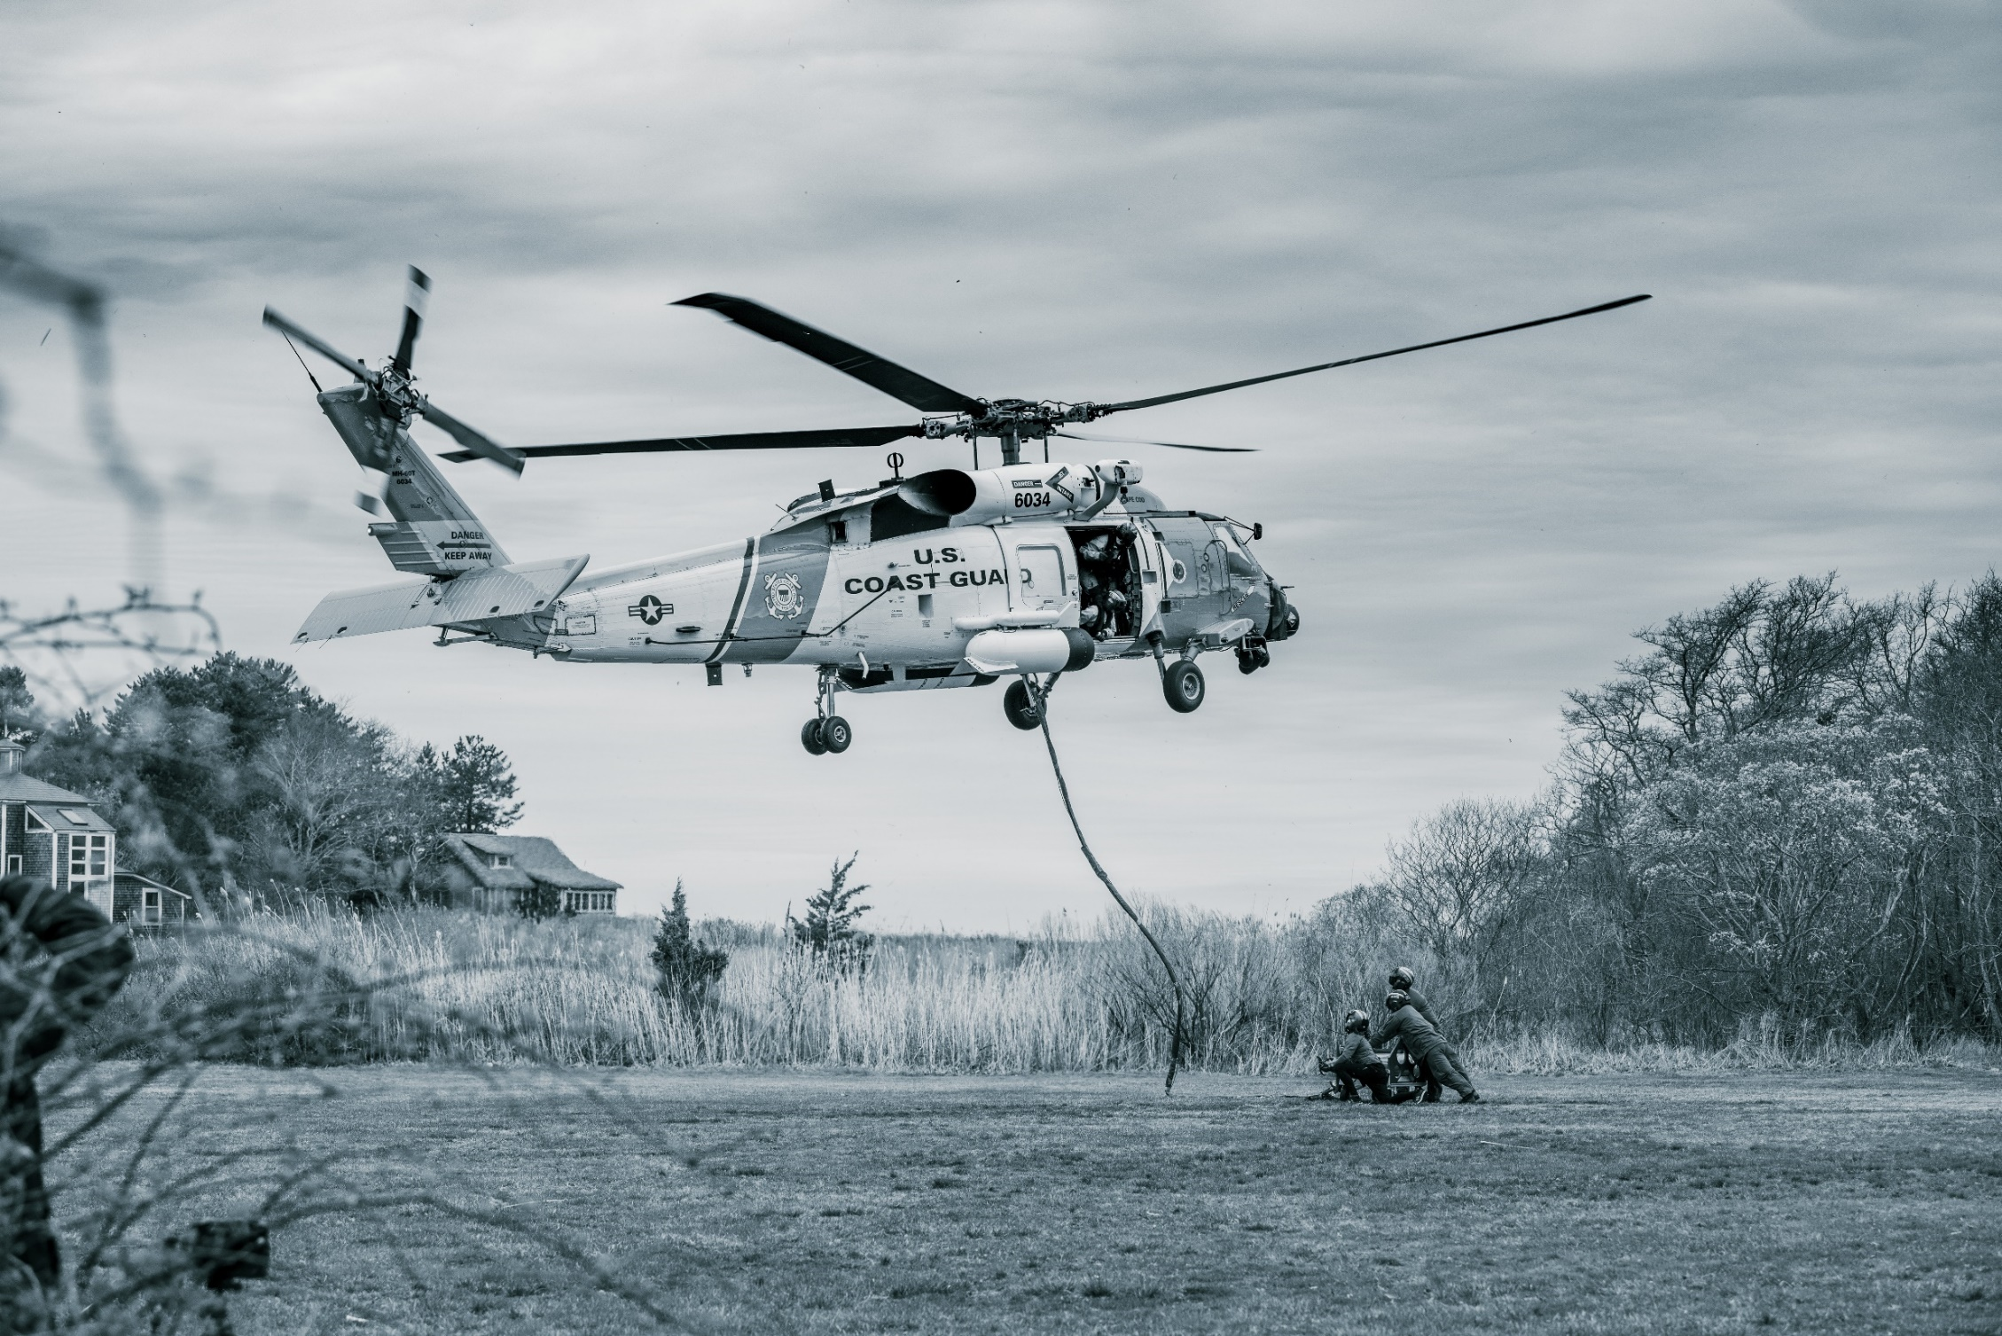
Transition…
Persistent observations on the order of weeks and spanning 10s–100s of km
Relevant observations require comprehensive sensing capabilities and investment

Slide 28
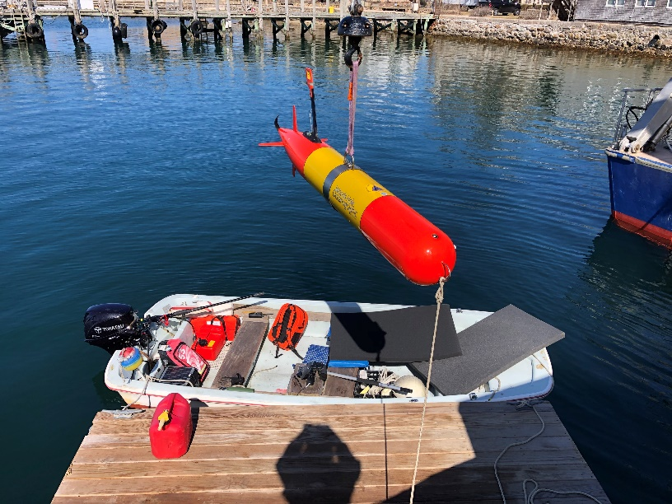
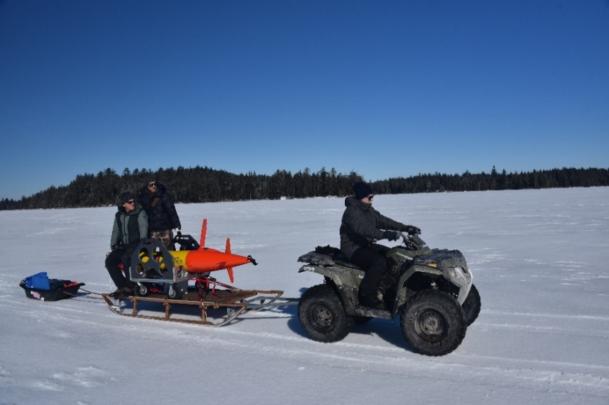
Project LRAUV: Transition Plans
Two-Stage Transition Plan:
  Build one or more systems to support USCG complete with successful open-water and under-ice demonstrations. WHOI trains USCG operators with support funding. WHOI can support USCG on site or remotely via iridium vehicle communications as needed. 24 hr support possible.
  Commercialize resulting platform: Based on lessons learned from (1), prepare the system for commercialization by accessing WHOI CMR fabrication resources. LRAUV was not designed for efficiency of manufacturing and rapid prototyping, therefore revisiting AUV design is a top priority.

Slide 29
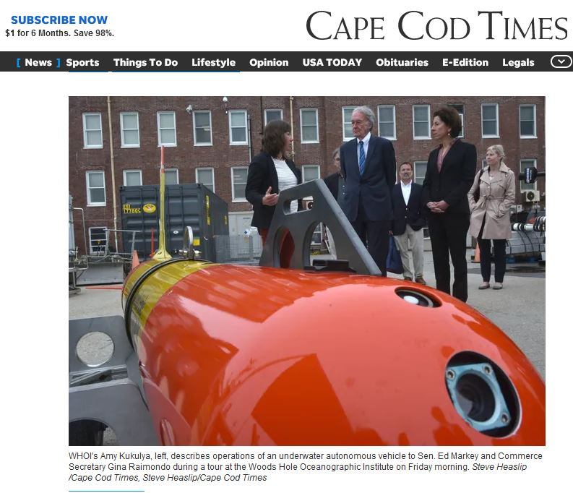
Project LRAUV: Transition Plans
Pathway to Transition:
Create an operational system that the USCG can use for characterizing spills in ice-covered ocean environments. Transition advantages of the LRAUV platform:
  Contains commercially available sensors
  Can be replicated for the USCG
  Has a proven vehicle design and proven reliability
  Sensor commonality

Slide 30
Project LRAUV: Transition Plans
Transition Plan includes the following:
  Facilities: WHOI operates facilities for fabrication, testing, logistics (on-ice support) and platforms such as ALVIN
  Service for-Hire: Operators and AUV’s such as the REMUS are available for hire and also have been transitioned into both the Navy and commercial sectors
  Hardware Builds: WHOI has a history of replicating systems and training end users
  Commercialization: Demand for WHOI built systems may occur through spin-off companies or through licensing the technology to a commercial entity. (example: Hydroid Kongsberg with REMUS and Bluefin from MIT, Bellingham)

Slide 31
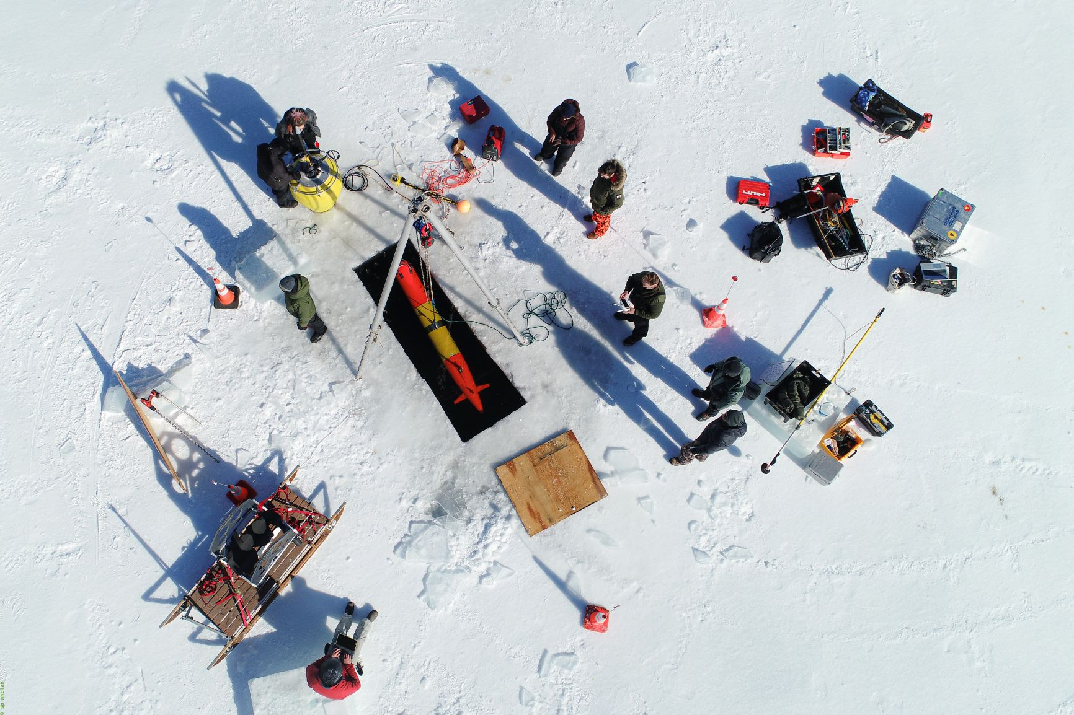


Thanks and
LRAUV Ready for questions

Slide 32
ADAC Year 8 Annual Meeting
ADAC Project Briefing
“Geofencing”
Dr. Shawn Butler
Assistant Term Professor
University of Alaska Anchorage

Slide 33
Break
9:45-9:55 AM AKDT
1:45-1:55 PM EDT
ADAC: Research for the Arctic Operator… For Today and For the Future

Slide 34
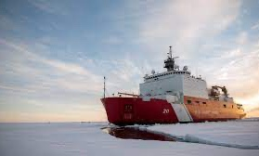
ADAC Year 8 Annual Meeting
...Via Conference Call, 20-21 April 2022
ADAC Project Briefing
Arctic Ice Condition Index
Jifeng Peng, University of Alaska Anchorage
Shawn Butler, University of Alaska Anchorage
Jinlun Zhang, University of Washington
Kelsey Frazier, University of Alaska Anchorage

Slide 35
ADAC Year 8 Annual Meeting
...Via Conference Call, 20-21 April 2022
ADAC Project Briefing
Arctic Ice Condition Index
Jifeng Peng, University of Alaska Anchorage
Shawn Butler, University of Alaska Anchorage
Jinlun Zhang, University of Washington
Kelsey Frazier, University of Alaska Anchorage

Slide 36
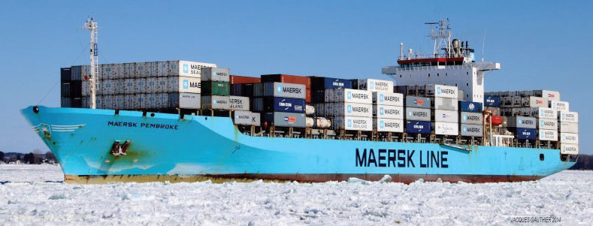
ADAC Program Year 8 Annual Meeting 19-20 April 2022
Arctic Ice Conditions Index (ARCTICE)
Expert Advisors
Project Champions
  CDR Christopher Tuckey,
  CG-WWM
Project Support
  Sam Cheung, CG RDC
Project Collaborators
  Jonathan Edwards-Opperman, NIC
  Capt. (Ret) Phillip Thorne, CG D17
  Axiom Data Science
USNIC Scientists
  Sofia Montalvo
  Michael Lowe
  Bailey Miller from USNIC

Slide 37
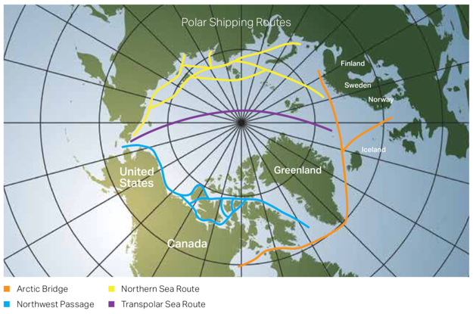
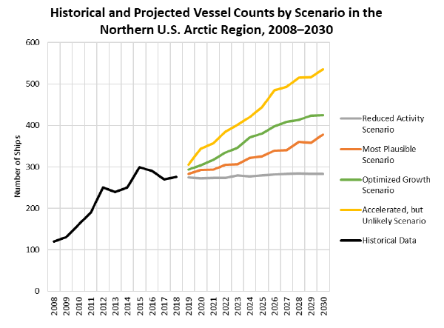
ADAC Program Year 8 Annual Meeting 19-20 April 2022
Arctic Ice Conditions Index (ARCTICE):
Relevance to DHS and USCG
Retreating sea ice has increased Arctic shipping and transportation viability
Polar shipping routes
From U.S. Committee on the Marine Transportation System

Slide 38
ADAC Program Year 8 Annual Meeting 19-20 April 2022
Arctic Ice Conditions Index (ARCTICE)
Relevance to DHS and USCG
Ship Traffic
Situational Awareness
LNG
Tourism
Exploration
Deterrence
Comms
Risks
SAR
Ice Conditions
There is no current publication of the severity of ice conditions and associated risk related to specific vessel classes
In order to ensure the safety and security of the vessels, personnel, and the environment, it is important to develop a high resolution ARCTICE to support Arctic mariner decision making
Notes:
Exponential increases in ship traffic through US Arctic EEZ
Foreign industry is transporting LNG through Chukchi and Bering Sea year round, attracting interest from other companies and nations
Arctic mariners experience long distances between ports of call, communication shortfalls, increasingly unpredictable weather patters, and limited USCG SAR availability
Vessels historically have travelled through the ice without knowledge of potential risks from the sea ice, sometimes getting stuck and needing assistance
There is no current publication of the severity of ice conditions and associated risk related to specific vessel classes
In order to ensure the safety and security of the vessels, personnel, and the environment, it is important to develop a high resolution ARCTICE to support Arctic mariner decision making

Slide 39
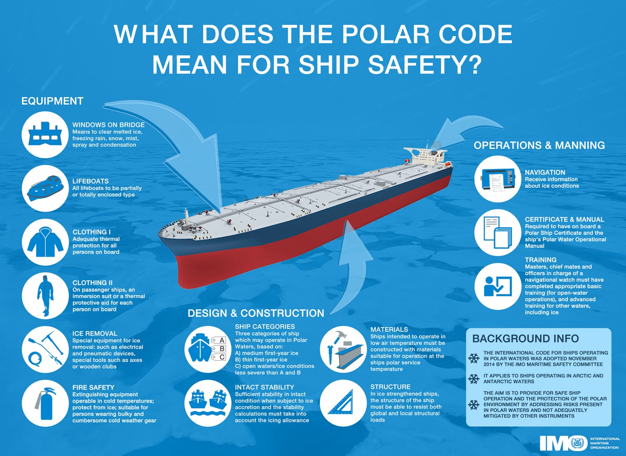
ADAC Program Year 8 Annual Meeting 19-20 April 2022
Arctic Ice Conditions Index (ARCTICE)
Description and Baseline
Leveraging team and research skills which developed Great Lakes ICECON, project ARCTICE will develop a high-resolution ice condition index for U.S. Arctic Maritime Exclusive Economic Zone (EEZ), including Bering, Chukchi and Beaufort Sea regions
ARCTICE produces an easy-to-understand numeral to communicate ice conditions that are relevant to the capabilities of an individual vessel. This index will be available for current and future ice conditions, providing forecasts up to 1 month in advance
ARCTICE supports vessel captains and officers in route planning and determining associated risk for traveling through a region of Arctic water

Slide 40
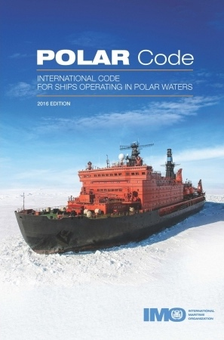
Arctic Ice Conditions Index (ARCTICE)
Description and Baseline
ADAC Program Year 8 Annual Meeting 19-20 April 2022
Historically many Arctic nations use their own methods for communicating ice conditions. Following the addition of the “POLARIS amendment” to the International Maritime Organization (IMO) Polar Code, communication tools on ice conditions started to migrate to a uniform methodology.
The POLARIS amendment to the IMO Polar Code is based on vetted ice condition processes from the Canadian AIRSS system, the Russian Ice Certificate concept, and additional inputs from other coastal administrators.
While the IMO has no existing or planned international enforcement privileges, the IMO Polar Code is seen as a “best practices” guide, many nations require that vessels comply with the Polar Code.

Slide 41
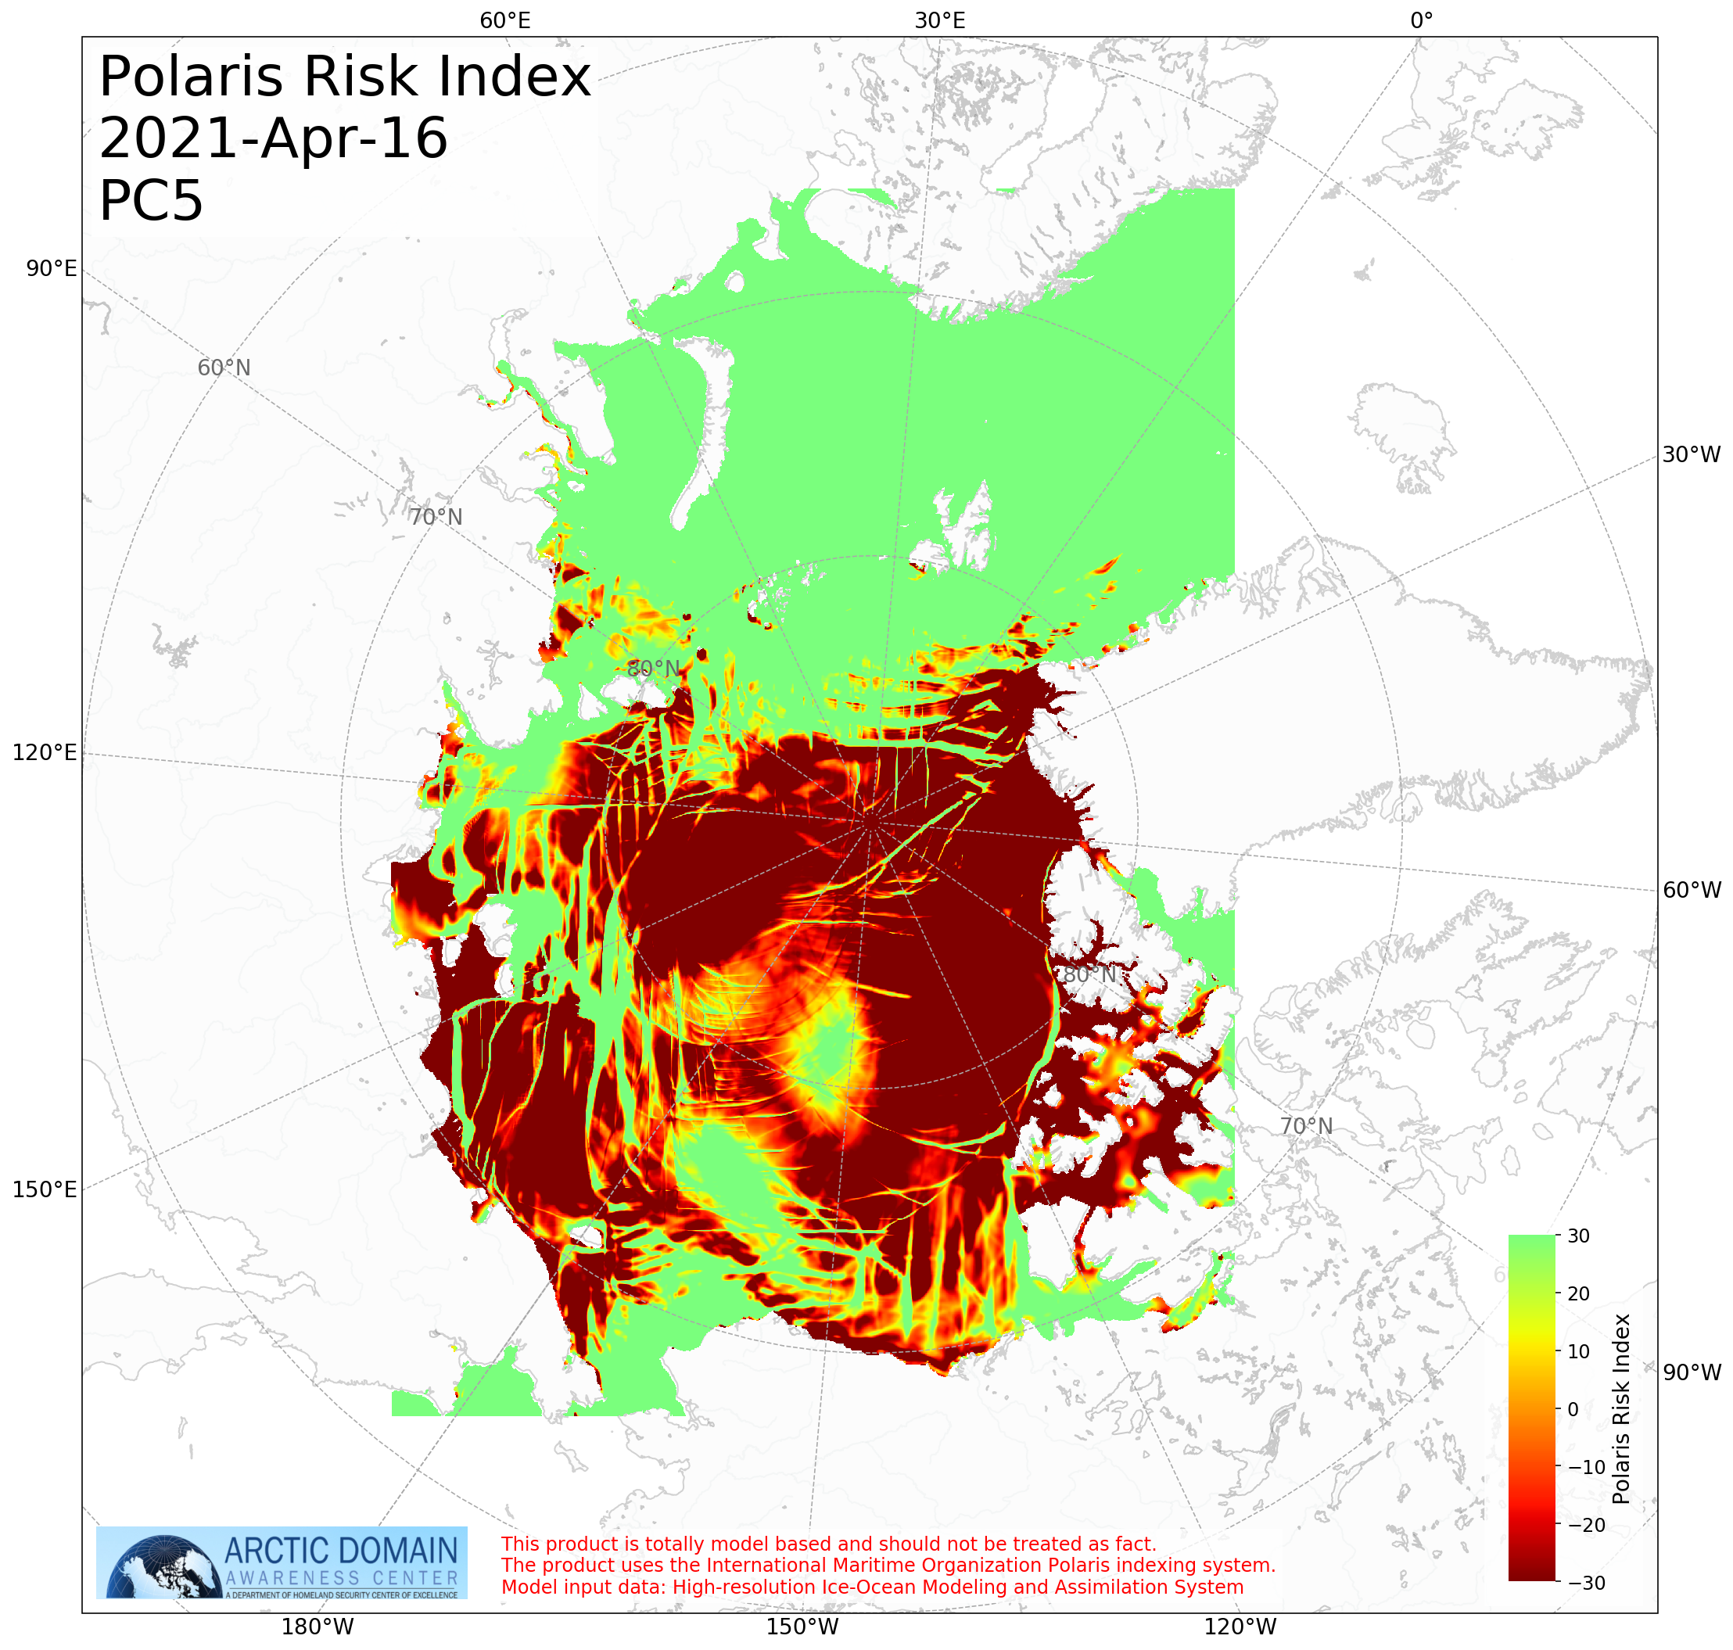
ADAC Program Year 8 Annual Meeting 19-20 April 2022
Arctic Ice Conditions Index (ARCTICE)
Prior Work Completed
Provide and confirm the ARCTICE vessel classification index;
Investigate other national models (in particular, Canadian programs)
Determine suitable environmental factors;
Integration of the index to a visualization tool as an aid to vessel mariner planning and underway activities;
Transition the ARCTICE to an operational destination.

Slide 42
ADAC Program Year 8 Annual Meeting 19-20 April 2022
Arctic Ice Conditions Index (ARCTICE)
Project year 8 workplan
Task 1: Finalize the validation efforts for the ARCTICE algorithm. Completed.
Task 2: Increase the accessibility of ARCTICE products. Completed.
Task 3: Transition the ARCTICE to an operational destination. Partially Completed.
Task 4: Investigate application of ARCTICE RIO charts to forecast Bering Strait traffic bound for a future Arctic Port in Nome, AK. Completed.

Slide 43
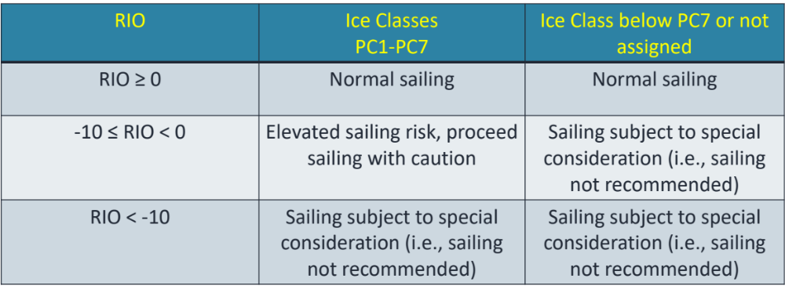
ADAC Program Year 8 Annual Meeting 19-20 April 2022
Arctic Ice Conditions Index (ARCTICE)
Project year 8 workplan
  Task 1: Finalize the validation efforts for the ARCTICE algorithm.
  Received part of the ice data from USNIC on board Healy (acknowledgement to Sofia Montalvo, Michael Lowe and Bailey Miller from USNIC);
  The accuracy of the ARCTICE model was evaluated based on the 3 ranges of RIO values listed in Table 1. The accuracy of the ARCTICE model depends on the ship ice class.
For more ice-capable ships such as Healy, the model is accurate and indicated ‘normal sailing’ on all recorded locations.
However, the input data used for the ARCTICE model sometimes underestimates the ice thickness, especially in the marginal ice zones, and therefore creates some discrepancies of RIO value for less ice-capable ships.
For example, using the same data from Healy, the ARCTICE model accuracy is only 72% for an PC7 (least ice capable) ship.

Slide 44
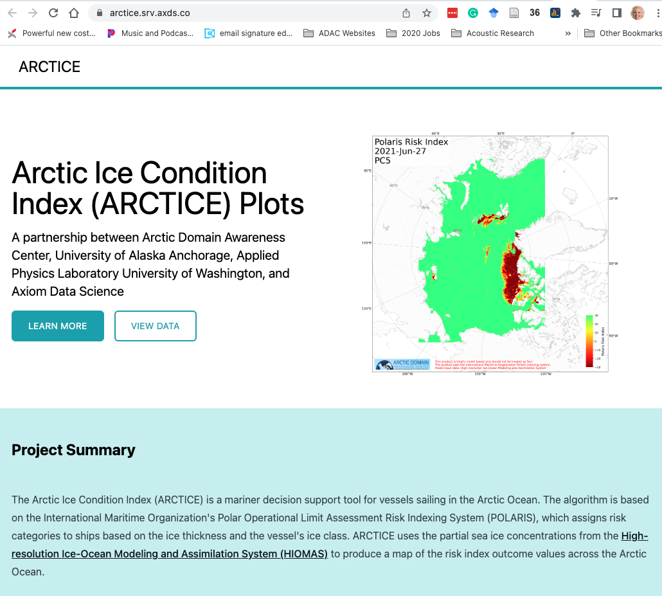
ADAC Program Year 8 Annual Meeting 19-20 April 2022
Arctic Ice Conditions Index (ARCTICE)
Project year 8 workplan
Task 2: Increase the accessibility of ARCTICE products
The research team, alongside Axiom employees, investigated ease of access and built a front-facing website for the products aimed for on-board and mobile device usage.
The website is https://arctice.srv.axds.co/. The website also includes instructions for users to easily use the product.
Another value-added element proposed is the inclusion and offering of ArcGIS capable data sets allowing onshore use such as route planning.

Slide 45
ADAC Program Year 8 Annual Meeting 19-20 April 2022
Arctic Ice Conditions Index (ARCTICE)
Project year 8 workplan
Task 3: Transition the ARCTICE to an operational destination
ARCTICE is operational and maintained by Axiom Data Science
Final federally-owned operational destination is currently under discussion. Working to maintain longevity of the system.

Slide 46
ADAC Program Year 8 Annual Meeting 19-20 April 2022
Arctic Ice Conditions Index (ARCTICE)
Project year 8 workplan
Task 4: Investigate application of ARCTICE RIO charts to forecast Bering Strait traffic bound for a future Arctic Port in Nome, AK
Investigated application of ARCTICE RIO charts to forecast Bering Strait traffic bound for a future Arctic Port in Nome, AK:
  Analyzed ARCTICE data for year 2021 at Bering Strait;
  The days of safe passage at Bering Strait in year 2021 for various ice class vessels are listed in Table.
Vessel ice class | PC1 | PC2 | PC3 | PC4 | PC5 | PC6 | PC7 | 1A super | 1A | 1B | 1C
Days for safe passage in 2021 | 365 | 365 | 365 | 365 | 365 | 362 | 359 | 352 | 317 | 275 | 254

Slide 47
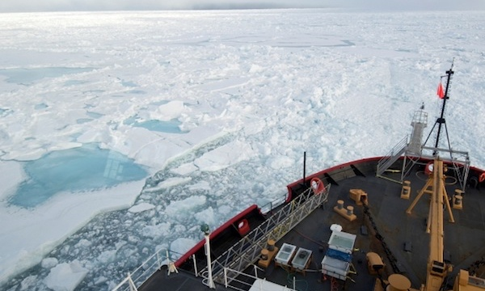
ADAC Program Year 8 Annual Meeting 19-20 April 2022
Ready for Questions
Feedback…
What are we missing?
What can we improve?
Who should we connect with to improve odds of research success?
Notes:
Thank you for the gift of your time and attention.

Slide 48
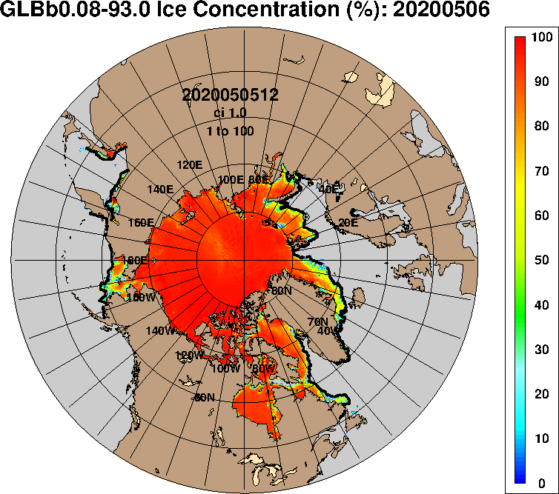

ADAC Year 8
ADAC Project Briefing
Oil Spill Modeling for Improved Response to Arctic Maritime Spills
Nancy E. Kinner and Tori Sweet
Coastal Response Research Center
Center for Spills and Environmental Hazards
University of New Hampshire
Image Source: https://www7320.nrlssc.navy.mil/GLBhycomcice1-12/arctic.html

Slide 49
ADAC Year 8
ADAC Project Briefing
Oil Spill Modeling for Improved Response to Arctic Maritime Spills
Nancy E. Kinner and Tori Sweet
Coastal Response Research Center
Center for Spills and Environmental Hazards
University of New Hampshire
Image Source: https://www7320.nrlssc.navy.mil/GLBhycomcice1-12/arctic.html

Slide 50
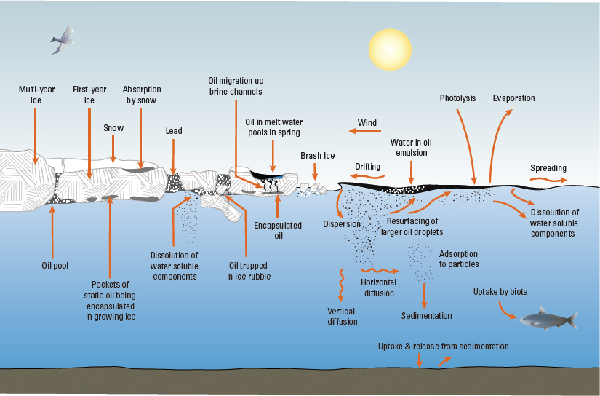
Oil Spill Modeling for Improved Response to Arctic Maritime Spills
Project Principal Investigators: Nancy E. Kinner
Lead Institution: University of New Hampshire Coastal Response Research Center (CRRC), Center for Spills and Environmental Hazards
Project Champion: Kristen Trego (HQ USCG 5RI)
Project Support:
  Sarah Allan (NOAA OR&R ARD)
  MST1 Gary Barnum (PacArea MST1)
  Catherine Berg (NOAA OR&R ERD SSC)
  Mike Donnellan (Alaska DEC)
  Mark Everett (USCG D17)
  Amy MacFadyen (NOAA OR&R ERD)
  Dr. Phillip McGillivary (USCG PacArea)
  LCDR Cliff Graham (HQ USCG MER)
Project Advocates: NOAA ORR and USCG PACAREA and D17
Oil and Ice Interactions
Source: Fisheries and Oceans Canada

Slide 51
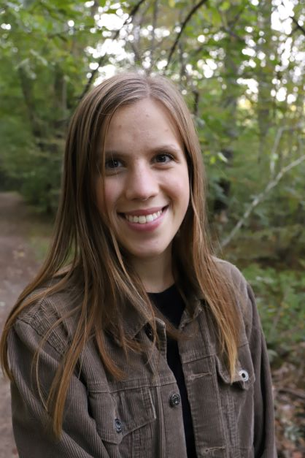


Oil Spill Modeling for Improved Response to Arctic Maritime Spills
ADAC Fellows for AMSM Project
Megan Verfaillie’s Thesis Defense = May 18, 2021
Jessica Manning Senior Thesis = May 20, 2021
Tori Sweet = Senior graduating in May 22, 2022
Jessica Manning
Megan Verfaillie
Tori Sweet

Slide 52
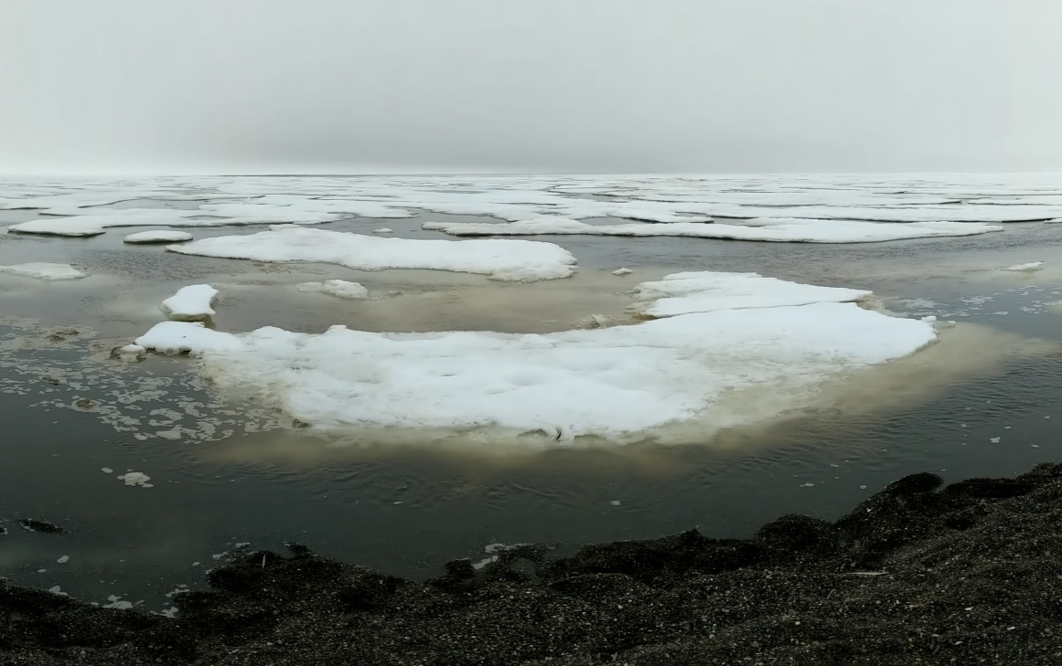
Oil Spill Modeling for Improved Response to Arctic Maritime Spills
Baseline: Arctic Environment
Arctic Specific Challenges:
  Limited response infrastructure / personnel
  Sparse observational data
  Extreme weather conditions
  Extended periods of darkness
  Long term impacts
  Lower temperatures impact oil behavior and weathering
  Ice is complex
  Oil may become frozen into ice

Slide 53

Oil Spill Modeling for Improved Response to Arctic Maritime Spills
Relevance: Emergency Response
Key Players:
  Incident Command System used by federal government for emergencies
  Unified Command:
    Develops objectives / strategies
    Improves information flow
    Optimizes combined efforts
  USCG responds to marine shipping accidents in U.S. waters
  NOAA ORR provides scientific support to USCG FOSC during oil spill response
Image Source: https://nrt.org/sites/2/files/UC%20TAD%201-26-07%20FINAL.pdf

Slide 54


Oil Spill Modeling for Improved Response to Arctic Maritime Spills
Baseline : Oil Spill Models
Oil spill models:
  Predict the fate & transport of spilled oil
  Use a particle tracking (Lagrangian) based approach
  Are made in U.S. & internationally
  Public or private
Image Source: GNOME User Manual

Slide 55


Oil Spill Modeling for Improved Response to Arctic Maritime Spills
Baseline : Oil Spill Models
Response models must:
  Initialize quickly (provide answers within hours)
  Calibrate easily
  Model at a wide range of spatial / temporal scales
  Run with minimal data inputs
Primary U.S. Oil Spill Models
NOAA GNOME
RPS OILMAP & SIMAP

Slide 56

Transport
Fate (Weathering)
Oil Spill Models Predict:
Fate & Transport of Oil
Advection
Emulsification
Dispersion
Photo-Oxidation
Sedimentation
Dissolution
Biodegradation
Spreading
Evaporation

Slide 57
Oil Spill Models are Used for:
Directing Response Activities
Informing Stakeholders / Public
Analyzing Performance of
Cleanup Techniques
Identification of Habitats &
Species at Risk

Slide 58

Oil Spill Modeling for Improved Response to Arctic Maritime Spills
Baseline: Ice Models
Simulate future data about ice conditions
Operate independent of oil spill models
  Essential for estimating spreading &
  transportation of oil in ice
  May be coupled with ocean, land, and/or atmosphere models
Provide long-term, seasonal, & short-term forecasts
Operate at global / climate (> 1 – 2 km) & “sub grid” scales (< 1 km)
Image Source: https://arcticdomainawarenesscenter.org/P08_HIOMAS

Slide 59
Oil Spill Modeling for Improved Response to Arctic Maritime Spills
Baseline : Ice Models
Ice Models Predict: Future Ice Conditions
Morphology
Physics
Thickness
Ice-Atmosphere
Ridges
Growth & Melt
Biogeochemistry
Floe Size
Ice-Ocean
Source: Adapted from Sea Ice Model Provenance Diagram by Andrew Roberts, Elizabeth Hunke, Bonnie Brown, and Nicole Jeffery

Slide 60

Oil Spill Modeling for Improved Response to Arctic Maritime Spills
Baseline : Ice Observing Systems
Use satellite resources to identify sea ice:
  Concentration
  Velocity
  Thickness
Information availability based on:
  Satellite orbits
  Radar calibration times
  Environmental conditions (e.g., clouds)
Can provide high resolution data (~10 m)
Use sea ice / hydrodynamic models to predict future conditions
U.S. National Ice Center & NWS AK Sea Ice Program

Slide 61
Description
Oil Spill Modeling for Improved Response to Arctic Maritime Spills Years 6-7
Project provides structured approach to gather expert advice to develop models that address USCG Federal On Scene Coordinator (FOSC) core needs during Arctic spill response.
Overall objective is to identify:
  Specific needs to be addressed to obtain models that will be functional and effective in response time scale to advance FOSC decision-making during an incident as well as improve experience gained from exercises and drills
  Current state-of-the-art Arctic maritime oil spill response models
  Potential integration of these models and components from recent research efforts (integration of ice models with oil spill models)
  Gaps in current models that need to be addressed by future research
Project outcome: Knowledge product/comprehensive report that delineates characteristics of Arctic oil spill response that make models appropriate required for daily response planning and decision-making

Slide 62
Oil Spill Modeling for Improved Response to Arctic Maritime Spills
Define Needs Addressed by Response Models
Project Core Team meeting held on May 2019
Produced Needs / Questions related to:
  Responder / FOSC Needs
  Overview & concerns for existing models
  Desired capabilities for new models
  Confidence level & communication
  Validation of models
  Suggestions for first workshop
Needs / Questions finalized by Core Team on July 31, 2019

Slide 63

Oil Spill Modeling for Improved Response to Arctic Maritime Spills
Workshop 1 on AMSM Modeling
AMSM Workshop (December 3-5, 2019):
  49 participants from U.S. & International
  Presentations on oil spill & ice models available for Arctic
  Three different breakout group scenarios:
    Well blowout under ice
    Pipeline spill under landfast ice
    Large vessel spill of combinations of oil in the shoulder season (Fall)
  Workshop report completed January 2020

Slide 64
Oil Spill Modeling for Improved Response to Arctic Maritime Spills
Formation of Working Groups
Working Group Topics were determined at December 2019 workshop
Met March - November 2020
  Online every 3 weeks for 1 hour (~ 12 meetings
  per group)
  Each group has NOAA ORR modeling
  representative
Group Topics were determined at December 2019 workshop
Met March - November 2020
Working Group Topics
Oil & Ice Interactions at the Meter / “Sub Grid” Scale
Oil & Ice Interactions at the Kilometer + Scale
New and Existing Technologies for Observing Ice and Informing Models
Visualization & Uncertainty

Slide 65
Oil Spill Modeling for Improved Response to Arctic Maritime Spills
Virtual Workshop
Three parts:
  Workshop: November 16, 2020 (~ 75 participants)
  Stakeholder Working Session I: November 23, 2020
  Stakeholder Working Session II: November 30, 2020
Groups presented goals, research gaps, & findings
Stakeholder Working Sessions focused identifying research needs / scopes of work
9 workshop
Met March - November 2020

Slide 66

Oil Spill Modeling for Improved Response to Arctic Maritime Spills
Findings and Key Accomplishments
Communication of Uncertainty
FOSCs are concerned with:
  Most likely prediction
  Worst-case scenario
  Implications on response
Qualitative confidence level
(low, medium, high) sufficient
for decision-making
Spill modelers usually have idea
of qualitative uncertainty of outputs

Slide 67

Oil Spill Modeling for Improved Response to Arctic Maritime Spills
Findings and Key Accomplishments
AMSM Confidence Estimates of Oil Model Inputs & Outputs (CEOMIO)
Identifies:
  Sources of uncertainty
  Qualitative confidence levels for
  inputs / outputs over spill duration
  Input data gaps & quality issues
Next step: sub-group of oil spill modelers and
SSCs using model output and data from
previous incidents to create draft tables
  Tables will be introduced to responders at a seminar and/or tabletop
  Also presented to other relevant groups (e.g., Alaska RRT)

Slide 68
Oil Spill Modeling for Improved Response to Arctic Maritime Spills
Findings and Key Accomplishments
AMSM Confidence Estimates of Oil Model Inputs & Outputs (CEOMIO)

Slide 69
Oil Spill Modeling for Improved Response to Arctic Maritime Spills
Findings and Key Accomplishments
Technology / Data Needs for Arctic Spill Response
Created spreadsheet describing:
  Contact / Manufacturer
  Overview
  Sensor Description
  Operating Conditions
  Spatial & Temporal Resolution
  Time Required for Measurements
  Availability / Time for Mobilization
  Permit Requirements
  Raw & Final Data Formats
  Validation Studies
Satellites
Airborne
On Ice Surface & Subsurface
Under Ice & Open Water Surface
Seafloor Mounted

Slide 70
Oil Spill Modeling for Improved Response to Arctic Maritime Spills
Findings and Key Accomplishments
Technology / Data Needs for Arctic Spill Response
Determined technology applicability and limitations for two spill scenarios:
Large Vessel Spill of Combinations of Oil in the Shoulder Season
Pipeline Spill Under Landfast Ice

Slide 71
Oil Spill Modeling for Improved Response to Arctic Maritime Spills
Findings and Key Accomplishments
State-of-the-Art Models
Completed a comprehensive review of state-of-the-art oil spill and ice models / forecast systems available
  Produced tables on state-of-the-art oil spill & ice models
    Spreadsheets include logistical information (e.g., scales, file formats), algorithms, necessary inputs, and outputs
  Oil spill modelers created lists of:
    Current limitations for oil in ice algorithms
    Outputs from sea ice models useful for improving Arctic oil spill modeling

Slide 72
Oil Spill Modeling for Improved Response to Arctic Maritime Spills
Findings and Key Accomplishments
Model Integration: Scale of Available Data
  Most ice models operate at the global / climate or sub grid scale
  Ice observing systems can produce needed resolution, but are limited by weather, satellite revisit periods & ingestion into models
Major obstacle for improving interoperability

Slide 73
Oil Spill Modeling for Improved Response to Arctic Maritime Spills
Findings and Key Accomplishments
Model Integration: Scale of Available Data
Oil spill modelers want data at 1 km spatial resolution & hourly temporal resolution
Challenging to produce at these scales
  1 km is intermediate scale between climate / global & sub grid scale
  Averaging of data across grid cells does not adequately represent regional scale processes in response timeframe
  Required computing power / data storage
  Technology limitations / data availability

Slide 74

Oil Spill Modeling for Improved Response to Arctic Maritime Spills
Findings and Key Accomplishments
Many important small-scale oil-in-ice processes are not modeled
Most important is estimation of under ice storage capacity
  Based on roughness & stripping velocity
  Few data available for under ice conditions
  Relationship between under ice and surface conditions is not well understood
  “Rule of thumb” needed to estimate holding capacity of sea ice
CRRC is Currently Working on this Issue:
Jess Manning’s master's thesis research
Using CRRC flume
Advisory team includes researchers from AMSM working groups including Kelsey Frazier
Source: Kelsey Frazier, ADAC, December 2019 Workshop Presentation: “Oil and Ice”

Slide 75

Oil Spill Modeling for Improved Response to Arctic Maritime Spills
Knowledge Product
Knowledge product/comprehensive report delineated characteristics of Arctic oil spill response that make models appropriate for daily response planning and decision-making
Key findings:
  Determine the exact sea ice model/observational data feeds that are needed by Arctic oil spill models
  Create, implement and test the code necessary to ensure that those data
can be ingested directly by oil models during spill in timely and accurate way
  Conduct test to validate sea ice inputs will lead to improved Arctic spill model trajectories
    Enhance FOSC decision-making
Source: Kelsey Frazier, ADAC, December 2019 Workshop Presentation: “Oil and Ice”

Slide 76

Oil Spill Modeling for Improved Response to Arctic Maritime Spills
Year 8: AMSM Path Forward
Year 8 determined necessary data feeds existing hydrodynamic and sea ice models to predict trajectory of oil in ice
  Coding to get data from
  ice models / services ready
  for ingestion into oil spill models
  Test linkage between ice and oil spill models

Slide 77


Oil Spill Modeling for Improved Response to Arctic Maritime Spills
Year 8: AMSM Path Forward
Parameters GNOME needs:
  Ice velocity, ice direction, % ice cover
  netCDF format
  Scale: 1 km
  Location: latitude and longitude
  Velocities: U and V (northing and easting)
  Winds: degrees from North and Velocity (knots)

Slide 78
Oil Spill Modeling for Improved Response to Arctic Maritime Spills
Year 8: AMSM Path Forward
Coordinating with NOAA ORR modelers on GNOME algorithms
  Coordination has occurred with:
    HIOMAS sea ice model already linked to GNOME
    Facilitated mtg with Zhang, Axiom Data Science and ORR
      Well coordinated already
      Too much computer power needed to 1 km resolution and 1 hour time interval with prediction up to 30 days
      If only up to 72 hr, less computer time required
      They can be flexible, if spill occurs

Slide 79
Oil Spill Modeling for Improved Response to Arctic Maritime Spills
Year 8: AMSM Path Forward
Coordinating with NOAA ORR modelers on GNOME algorithms
  Coordination has occurred with:
    AK Sea Ice Program
      Sea ice shapefiles
    NOAA National Environmental Satellite Data and Information Service (NESDIS)
      Satellite data can provide coverage of the Arctic, but there are gaps in data.
      Not at a 1 km scale, but a request could be made for this type of product to be produced in future and during spill

Slide 80
Oil Spill Modeling for Improved Response to Arctic Maritime Spills
Year 8: AMSM Path Forward
Coordinating with NOAA ORR modelers on GNOME algorithms
  Coordination with US National Ice Center (NIC)
      Uses GOFS (HYCOM + CICE) for data ingestion
      Can provide the data needs for GNOME (ice velocity, direction, and % ice cover)
      Not a 1 km scale, but potentially during an emergency/as needed basis
      Data originates in a netCDF format from GOFS
      Potential for GNOME to use data directly from GOFS and the NIC shapefiles/polygons for analysis

Slide 81
Oil Spill Modeling for Improved Response to Arctic Maritime Spills
Year 8: AMSM Path Forward
Coordinating with NOAA Sea Ice modelers on GNOME algorithms:
  Coordination has occurred with:
    CICE
      NOAA uses RTOFS (HYCOM + CICE) with slight difference from GOFS
      Can provide the data needs for GNOME (ice velocity, direction, and % ice cover).
      3 km scale for Arctic

Slide 82
Oil Spill Modeling for Improved Response to Arctic Maritime Spills
Year 8: AMSM Path Forward
Narrowed the search to two sea ice organizations:
  GNOME may eventually use
  both models to better determine
  uncertainty in trajectory prediction
Sea Ice Organization
NIC/US Navy
NOAA
GOFS: Ingests Data
(creates a physical field and replaces model’s data)
RTOFS: Assimilates Data (does not automatically replace the model’s data)

Slide 83
Oil Spill Modeling for Improved Response to Arctic Maritime Spills
Year 8: AMSM Path Forward
CRRC student computer programmer
  Currently working on coding sea ice data to input into GNOME
  Working with GOFS
  Once coding is completed, validation test will occur
  Scenario will be provided to modelers
    GOFS model will produce input for GNOME to ensure it can be ingested and GNOME will produce a plausible oil trajectory

Slide 84
Oil Spill Modeling for Improved Response to Arctic Maritime Spills
Year 8: AMSM Path Forward
Sea Ice Working Group
  Will be formed consisting of sea ice experts and oil spill modelers to ensure that sea ice data will be input into GNOME during Arctic spills in future
  Goals:
    Continued communication between sea ice and oil spill modelers
    Ensure that sea ice data continues to be compatible with GNOME coding
    Will be hosted semi-annually by CRRC
    Currently identifying sea ice experts for working group

Slide 85
Oil Spill Modeling for Improved Response to Arctic Maritime Spills
Year 8: AMSM Path Forward
Timetable:
  Begin coding immediately after coordination with sea ice modelers
  Test linkages in late Spring 2022
  June NOAA modelers and ice model/observation teams test system
  Finish Knowledge Product Addendum
Budget: No Issues

Slide 86

Questions?
Feedback…
What are we missing?
What can we improve?
Who should we connect with to improve odds of success?
Thank You Very Much for Listening
Notes:
Thank you for the gift of your time and attention.

Slide 87

ADAC Year 8 Annual Meeting
...Via Conference Call, 20-21 April 2022
ADAC Project Briefing
Alaska and Arctic Maritime Communications and Connectivity Analysis
Dr. Doug Causey, Dr. Mark Ivey, Dr. Steve Kacenjar

Slide 88
ADAC Year 8 Annual Meeting
...Via Conference Call, 20-21 April 2022
ADAC Project Briefing
Alaska and Arctic Maritime Communications and Connectivity Analysis
Dr. Doug Causey, Dr. Mark Ivey, Dr. Steve Kacenjar

Slide 89




ADAC Project: Alaska and Arctic Maritime Communications and Connectivity Analysis
ADAC Program Year 8 Annual Meeting 19-20 April 2022
Principal Investigators:
Dr. Doug Causey, ADAC Principal Investigator, University of Alaska Anchorage (UAA)
Mr. Jason Roe, USCG (Ret), ADAC Associate Director & SRP, University of Alaska Anchorage (UAA)
Dr. Mark Ivey Sandia National Laboratories, Albuquerque NM
Project Champion:
CDR Sam Nassar, HQ USCG CG761, Washington D.C.
Technical researchers:
Mr. Bruce Heinrich, Arctic Slope Regional Corporation (ASRC) Federal Mission Solutions (ASRC FMS).
Mr. Greg Stihel and Mr. Matthew Ahlrichs, Sandia National Laboratories, Albuquerque NM.
CAPT Buddy Custard, USCG (Ret), Alaska Marine Prevention and Response Network, Juneau, AK.
CAPT Ed Page, USCG (Ret), Marine Exchange of Alaska, Juneau AK.
Ms. Ellee Matthews, ADAC Education and Administrative Manager.
Mr. Connor Keesecker, ADAC Communications and Research Associate.
Ms. Kelsey Frazier, ADAC Research Associate, UAA, Anchorage, AK.
Mr. Wade Albright, Alaska Satellite Facility, University of Alaska Fairbanks (UAF), Fairbanks, AK.

Slide 90

ADAC Project: Alaska and Arctic Maritime Communications and Connectivity Analysis
ADAC Program Year 8 Annual Meeting 19-20 April 2022
Arctic community outreach coordinators:
Mr. Nagruk Harcharek, Ukpeaġvik Iñupiat Corporation, Utqiaġvik, AK.
Mr. Kaare Erickson, Ukpeaġvik Iñupiat Corporation, Utqiaġvik, AK.
Project Stakeholders:
Mr. Shannon Jenkins, Senior Arctic Policy Advisor, HQ USCG 5PW, Washington D.C.
CAPT Russel “Rusty” Dash, HQ USCG CG51, Washington D.C.
Mr. Al Arsenault, Chief Technical Director, USCG R&D Center, New London CT.
Mr. Phil Thorne, Arctic Planner, USCG District 17, Juneau, AK.
LCDR Jereme Altendorf, USCG District 17 Sector Anchorage, AK.
Dr. Phil McGillivary, Science Advisor USCG Pac Area, Alameda CA.
Project Advisors:
Mr. Joe Hersey, USCG Civ. (Ret), RTCM Board Vice chair, GMDSS Task Force
Mr. Taylor Holshouser, Alaska Ocean Cluster, Anchorage AK.
Mr. Ken Flowers, Vice President, Government Solutions Iridium Corporation, McLean VA.
Mr. Bruce Hellenga, Operations Manager, ARCTICOM, LLC, Bering Straits Native Corporation, Anchorage AK.
Current Student Participation:
Mr. Talha Ali, ADAC Fellow, University of Alaska Anchorage

Slide 91

Alaska and Arctic Maritime Communications and Connectivity Analysis:
Description
ADAC Program Year 8 Annual Meeting 19-20 April 2022
Project Description:
To understand and assess the communication and connectivity challenges unique to the Alaskan and the U.S. Arctic maritime regions through a comprehensive review of mariner communications and connectivity needs, with a focus on near, mid-term, and long-term time horizons.
To provide an in-depth analysis of emerging technologies, and identify solutions that meet the needs and address the challenges of Alaskan and Arctic mariners
To support the public good by addressing marine communications and connectivity needs that affect mariner and Coastal communities across Alaska and the Arctic.

Slide 92

Alaska and Arctic Maritime Communications and Connectivity Analysis:
Baseline
ADAC Program Year 8 Annual Meeting 19-20 April 2022
Project Baseline:
Many Alaskan and Arctic mariners, including commercial and industry operators, subsistence hunters, and hundreds of village communities, continue to operate in a largely communications deprived environment, unable to connect ship-to-shore or, ship-to-aircraft (and vice versa), for weeks at a time.
From the 2019 USCG Arctic Strategic Outlook: “The high latitudes suffer from poor propagation of radio signals, geomagnetic interference, scant landside infrastructure, and limited satellite coverage and bandwidth. Some Arctic communities have cellular phone networks, but these are often constrained by limited coverage, capacity, and reliability. Closing the communications gap is a whole-of-government challenge and will require intensive partnerships across the interagency, industry, and the international community, as well as the State of Alaska and Alaska Native communities.”

Slide 93



ADAC Program Year 8 Annual Meeting 19-20 April 2022
Alaska and Arctic Maritime Communications and Connectivity Analysis:
Relevance
Reliable and effective communications with mariners is essential to all USCG mission areas.
  Reliable and effective communications with/among mariners:
    Reduces risk to mariners (Notice to mariners, safety broadcasts, weather broadcasts)
    Saves lives (Effective emergency response, alerting Good Samaritans)
    Increases Domain Awareness (mariner observations and reporting of pollution & obstructions)
    Reduces risks to responders (increased situational awareness, shortened search time, proper response resources)
    Protects the environment (fast and accurate reports of spills speed up response times and reduce amount of discharge)
    Reduces USCG investigative workload (Reports of Overdue mariners, shortens and increases the effectiveness of interviews)

Slide 94




ADAC Program Year 8 Annual Meeting 19-20 April 2022
Alaska and Arctic Maritime Communications and Connectivity Analysis:
Relevance

Slide 95
ADAC Program Year 8 Annual Meeting 19-20 April 2022
Alaska and Arctic Maritime Communications and Connectivity Analysis:
Method
Research Method:
This project included:
  a comprehensive review of mariner communications and connectivity needs for Alaska and the U.S. Arctic,
  a focus on near, mid-term, and long-term time horizons.
  leveraging a sequenced and iterative approach, with each phase informing subsequent research
    literature review
    establishment of a Core Advisory Team
    establishment of project working groups.
  the development of an in-depth market survey which served as the primary data-gathering stage
  the creation of a draft knowledge product
  a final capstone workshop to assess the draft knowledge product.
  the finalization of a comprehensive final knowledge product.

Slide 96
ADAC Program Year 8 Annual Meeting 19-20 April 2022
Alaska and Arctic Maritime Communications and Connectivity Analysis:
Phase 1: Conducting a comprehensive literature review completed
Literature review was oriented to identify the gaps and shortfalls of existing communications and connectivity systems in the U.S. Arctic
  First draft completed by the ADAC office with outstanding support from ADAC Fellows
  Second draft included additions by student intern at Sandia Labs
  Literature Review was finalized.

Slide 97
ADAC Program Year 8 Annual Meeting 19-20 April 2022
Alaska and Arctic Maritime Communications and Connectivity Analysis:
Phase 2: Forming the project Core Advisory team not completed
AAMC&CA Core Team was formed and regular meetings were held.
The Core team was formed and served to ensure the Project Investigators met the goals and objectives of the project. Throughout the duration of the project, members of the Core Team continued to participate in virtual assessments and was able to listen to all working group meetings.
  AAMC&CA Core Team currently had 32 members
  Team conducted 10 meetings The 11th meeting was planned for 18 October 2021 but was cancelled due to low participation in community engagement meetings and working group meetings.

Slide 98
ADAC Program Year 8 Annual Meeting 19-20 April 2022
Alaska and Arctic Maritime Communications and Connectivity Analysis:
Phase 3: Engaging the Community meetings, 10 completed, Oct 18 2021 Meeting cancelled
AAMC&CA Engaging the Community meetings were held as virtual, on-line meeting
  The Core Team with key project stakeholders worked together to establish Alaskan and Arctic maritime communication and connectivity needs, and defined the scope of project for stakeholders.
  Region 1: Southeast Alaska.
  Region 2: Southcentral Alaska (extending from Cordova to Kodiak, including Prince William Sound and Cook Inlet).
  Region 3: Alaska Peninsula and Aleutian Islands.
  Region 4: Bering Sea (extending from Bristol Bay Northward to Bering Straits, to include Norton Sound).
  Region 5: Chukchi Sea.
  Region 6: Beaufort Sea.

Slide 99
ADAC Program Year 8 Annual Meeting 19-20 April 2022
Alaska and Arctic Maritime Communications and Connectivity Analysis:
Phase 4: Establishing virtual Working Groups 12-14 October 2021 meeting was cancelled due to low participation.
AAMC&CA virtual Working Groups were defined and the first Working Groups meetings took place in July 2021
  The Core Team with key project stakeholders worked to clearly establish Alaskan and Arctic maritime communication and connectivity needs, and to define the scope of project for stakeholders.
  The Virtual Assessment scheduled for mid October 2021 was cancelled due to low participation.
  Arctic Region Working Group
  Non-Arctic Region Working Group
Working Group Tasks:
Grow stakeholder participation in Working groups
Validate critical AAMC&CA (Arctic and Non-Arctic) needs questions:
Validate (Arctic and Non-Arctic) User Stories:
Identify (Arctic and Non-Arctic) key technology types:
Identify Key (Arctic and Non-Arctic) Working Group technology presentations:
Validate/streamline proposed initial Market Survey Questions

Slide 100
ADAC Program Year 8 Annual Meeting 19-20 April 2022
Alaska and Arctic Maritime Communications and Connectivity Analysis:
Preliminary Research Summary:
Communications and project challenges include:
Market Survey reviewed and approved for release
Initial dissemination to stakeholders occurred in March 2022
Only 3 responses by Mid-April 2022
Sparse, limited, and outdated infrastructure
Mountainous terrain
Unpredictable weather
Extreme environmental conditions
Remote and difficult to reach locations
High maintenance costs
Significant logistics challenges
Wildlife…

Slide 101
ADAC Program Year 8 Annual Meeting 19-20 April 2022
Alaska and Arctic Maritime Communications and Connectivity Analysis:
Southeast Alaska Region:
Regional vessel traffic characterized by:
Frequent Large passenger vessel and Cruise Ship traffic during summer months
A large amount of small fishing vessels
Regular tug and barge traffic
A large amount of recreational vessel traffic
Image courtesy of Marine Exchange of Alaska

Slide 102



ADAC Program Year 8 Annual Meeting 19-20 April 2022
Alaska and Arctic Maritime Communications and Connectivity Analysis:
Southeast Alaska Region:
Regional communications challenges characterized by:
Small fishing vessels and recreational vessels that frequently transit VHF dead zones
VHF RFF/Site outages
VHF is most widely used communications method followed by cell phones
Satellites/Satellite communications blocked/disrupted by mountainous terrain
Unreliable Satellite speed of service
Sat phones and HF used only on larger vessels

Slide 103
ADAC Program Year 8 Annual Meeting 19-20 April 2022
Alaska and Arctic Maritime Communications and Connectivity Analysis:
Southeast Alaska Region:

Slide 104
ADAC Program Year 8 Annual Meeting 19-20 April 2022
Alaska and Arctic Maritime Communications and Connectivity Analysis:
Southcentral Alaska Region:
Regional vessel traffic characterized by:
Some Large passenger vessel and Cruise Ship traffic during summer months
A large amount of small fishing vessels
Regular tug and barge traffic
A large amount of recreational vessel traffic
Tanker traffic into Valdez and Cook Inlet
Image courtesy of Marine Exchange of Alaska

Slide 105

ADAC Program Year 8 Annual Meeting 19-20 April 2022
Alaska and Arctic Maritime Communications and Connectivity Analysis:
Southcentral Alaska Region:
Regional communications challenges characterized by:
Small fishing vessels and recreational vessels that frequently transit VHF dead zones
VHF outages
VHF is most widely used communications method followed by cell phones
Satellites/Satellite communications blocked/disrupted by mountainous terrain
Unreliable Satellite speed of service
Sat phones and HF used only on larger vessels
Several large weather forecast regions with differing conditions, ie PWS and Shelikof Strait
Glacial Fog and narrow waterways
Mariners with satellite service now use WhatsApp
  Info groups can be established

Slide 106

ADAC Program Year 8 Annual Meeting 19-20 April 2022
Alaska and Arctic Maritime Communications and Connectivity Analysis:
Chukchi Sea Region:
Regional communications challenges characterized by:
No USCG VHF site
Congested waterways in southern part of the region
No VHF weather broadcasts
VHF becomes a ‘party line” during subsistence activities
NWS has need for weather observations

Slide 107
ADAC Program Year 8 Annual Meeting 19-20 April 2022
VHF Communication Augmentation (Future Considerations)
Performed modeling simulation of existing infrastructure to identify possible improvements/upgrades
that could noticeably improve artic communications such as:
Repeater Tower Height Extension – Potential Near-term Low-cost Option*
- Effective-Earth Radius, Height Scaling Dependent upon the index of refraction atmospheric profile
Repeater Power Adjustment – Potential Near/midterm -term Option*
- Increase power
- Phase-array beaming
Exotic VHF Propagation Modes – Appear to be low reliability
- Sporadic-e (unreliable – Dependent upon the solar weather)
- Tropospheric ducting (unreliable – Dependent upon Temperate and Air density profiles)
- Auroral (unreliable in most areas of the world but might have value in the polar regions)
- Meteor scatter (unreliable and only provide shot burst information spans)
- Earth-Moon-Earth (time-dependent and moon is very low in the arctic sky)
Notes:
Thank you for the gift of your time and attention.

Slide 108

ADAC Program Year 8 Annual Meeting 19-20 April 2022
Archival Analysis of Artic Maritime Traffic through AIS data
Perform study of AIS archival traffic data using online services such as MarineTraffic. The increase in maritime traffic will have an impact on the reliability and quality of marine communications. This analysis will identify trends that can be used to help predict future maritime communication needs.
Traffic Trending Analyses
Assess Maritime Type Historical Trending such as for:
  Fishing ships
  Cargo vessels
  Tugs and special craft
  Pleasure Craft
Assess Historical Changes of Maritime Activity
  Daily cyclic activity
  Seasonal activity
Assess Historical Traffic Impacts to Weather Conditions
  Merge traffic archival data with NOAA archival weather to establish trending
  Examine ice-cover impacts on maritime traffic by merging maritime traffic with NOAA/NASA archival data
Notes:
Thank you for the gift of your time and attention.

Slide 109
ADAC Program Year 8 Annual Meeting 19-20 April 2022
Maritime Cognitive Radio Networks (MCRN) – Future Potential Implementation
In the future, the number of ships and services will grow with potential competition for limited communication
Bandwidth. An effective way to manage these limited resources is by implementing MCRN which utilizes SoA
Software Define Radio (SDR) Technology and Artificial Intelligence (AI) methods. What MCRN provides:
Overcome Radio Spectrum Scarcity: By sensing spectrum utilization, MCRN can broadcast on unused radio spectrum
Avoid Intentional radio Jamming Scenarios: By sensing channel availability and even predicting the jammer’s tactics, MCRN can evade jamming by dynamically and preemptively switching to higher quality channels.
Switch to Power Saving Protocol: By predicting rain/snow fade and reconfiguring transmitters/receivers for optimum bandwidth, MCRN improve communication quality when and where the information is needed most.
Improved Satellite Communications: By predicting rain/snow fade and reconfiguring transmitters/receivers for optimum bandwidth, MCRN improve communication quality when and where the information is needed most.
Improved Quality of Service: By sensing environmental and inadvertent man-made radio interferences, MCRN can select frequency channels with a higher Signal to Noise Ratio (SNR)
Notes:
Thank you for the gift of your time and attention.

Slide 110
ADAC Year 8 Annual Meeting
...Via Conference Call, 19-20 April 2022
ADAC Project Briefing
Alaska and Arctic Maritime Communications and Connectivity Analysis
BACKUP SLIDES

Slide 111
ADAC Program Year 8 Annual Meeting 19-20 April 2022
Alaska and Arctic Maritime Communications and Connectivity Analysis:
Southcentral Alaska Region:

Slide 112
ADAC Program Year 8 Annual Meeting 19-20 April 2022
Alaska and Arctic Maritime Communications and Connectivity Analysis:
Alaska Peninsula and Aleutian Island Region:
Regional vessel traffic characterized by:
High volume of foreign deep-draft vessel traffic
Large Fishing vessels
Very few passenger vessels and recreational vessels
Image courtesy of Marine Exchange of Alaska

Slide 113

ADAC Program Year 8 Annual Meeting 19-20 April 2022
Alaska and Arctic Maritime Communications and Connectivity Analysis:
Alaska Peninsula and Aleutian Island Region :
Regional communications challenges characterized by:
Almost no VHF infrastructure
Very remote region with great distances
Most vessels utilize HF, Satellite Communications, and AIS
Vessel contact difficult via Sat phone
AIS monitoring of foreign vessel traffic labor-intensive
Frequent severe weather
Need for greater fidelity with air temperature in marine broadcasts to assist with mitigating icing

Slide 114
ADAC Program Year 8 Annual Meeting 19-20 April 2022
Alaska and Arctic Maritime Communications and Connectivity Analysis:
Bering Sea Region:
Regional vessel traffic characterized by:
Large volume of large fishing vessels
Large volume of small fishing vessels near shore
Moderate amount of tank vessels
Moderate amount of tugs
Small recreational vessels traveling great distances offshore
Image courtesy of Marine Exchange of Alaska

Slide 115

ADAC Program Year 8 Annual Meeting 19-20 April 2022
Alaska and Arctic Maritime Communications and Connectivity Analysis:
Bering Sea Region:
Regional communications challenges characterized by:
Only one USCG VHF site (Tuklung Mountain)
Congested waterways in southern and northern parts of the region
Bering strait is a narrow international waterway with safety concerns
No VHF weather broadcasts in northern Bering Sea
Need for greater fidelity with air temperature in marine broadcasts to assist with mitigating icing
Mariners with satellite service now use WhatsApp
  Info groups can be established

Slide 116
ADAC Program Year 8 Annual Meeting 19-20 April 2022
Alaska and Arctic Maritime Communications and Connectivity Analysis:
Chukchi Sea Region:
Regional vessel traffic characterized by:
Most vessels transit near to shore
Moderate amount of Tug traffic
Small subsistence and recreational vessels travel great distances from shore
Image courtesy of Marine Exchange of Alaska

Slide 117
ADAC Program Year 8 Annual Meeting 19-20 April 2022
Alaska and Arctic Maritime Communications and Connectivity Analysis:
Chukchi Sea Region:
Regional communications challenges characterized by:
No USCG VHF site
Congested waterways in southern part of the region
No VHF weather broadcasts
VHF becomes a ‘party line” during subsistence activities
NWS has need for weather observations

Slide 118
ADAC Program Year 8 Annual Meeting 19-20 April 2022
Alaska and Arctic Maritime Communications and Connectivity Analysis:
Chukchi Sea Region:
Regional communications challenges characterized by:
No USCG VHF site
Congested waterways in southern part of the region
No VHF weather broadcasts
VHF becomes a ‘party line” during subsistence activities
NWS has need for weather observations

Slide 119
ADAC Program Year 8 Annual Meeting 19-20 April 2022
Alaska and Arctic Maritime Communications and Connectivity Analysis:
Beaufort Sea Region:
Regional vessel traffic characterized by:
Moderate amount of Tug traffic
Small subsistence and recreational vessels travel great distances from shore
Image courtesy of Marine Exchange of Alaska

Slide 120

ADAC Program Year 8 Annual Meeting 19-20 April 2022
Alaska and Arctic Maritime Communications and Connectivity Analysis:
Beaufort Sea Region:
Regional communications challenges characterized by:
No USCG VHF site
No VHF weather broadcasts
VHF becomes a ‘party line’ during subsistence activities
NWS has need for weather observations

Slide 121
ADAC Program Year 8 Annual Meeting 19-20 April 2022
Alaska and Arctic Maritime Communications and Connectivity Analysis:
Planned Research Outcomes:
A comprehensive knowledge product that includes:
A review of the current state-of-the-art Alaskan and U.S. Arctic maritime communications and connectivity technologies.
Recommendations and conclusions for near-term available state-of-the-art Alaskan and U.S. Arctic maritime communications and connectivity technologies suitable for USCG use.
Recommendations and conclusions for medium-and-long term future Alaskan and U.S. Arctic maritime communication and connectivity technologies.
Detailed recommendations and conclusions on Alaskan and U.S. Arctic maritime communications connectivity transition pathways (focused on Alaskan and U.S. Arctic maritime regions.

Slide 122
ADAC Program Year 8 Annual Meeting 19-20 April 2022
Alaska and Arctic Maritime Communications and Connectivity Analysis:
Key Accomplishments:
Conducted project kickoff meeting
Formed Core Team
Completed Second draft of literature review
Completed 36 Engaging the community meetings
Completed 10 Core Team meetings
Established Arctic and non-Arctic working groups
Conducted 6 sets of Working Group meetings
Developed and disseminated Market Survey*
Scheduled Virtual Assessment

Slide 123
ADAC Program Year 8 Annual Meeting 19-20 April 2022
Alaska and Arctic Maritime Communications and Connectivity Analysis:
Preliminary observations:
Identified need for NWS and Mariners to collaborate & better share information
  NWS expressed need for weather observations from mariners
    To help better understand local weather phenomena
    To potentially feed/improve models
  Mariners expressed need for spot forecasts
  Mariners identified several forecast areas as too large to be effective
  Mariners expressed a great need for more accurate air temperature information to prevent icing
VHF radio voice communications remains favored/first emergency communications method
  including areas well offshore and outside VHF range.
  Best/fastest way to notify nearest vessels potential Good Sam
WhatsApp is currently being utilized by mariners with mobile/underway broadband connectivity
  WhatsApp has the potential to utilize notification groups
Many smaller commercial vessels and small fishing vessels are unaware of complete suite of broadcasts
  NAVTEX
Some smaller commercial vessels and small fishing vessels have operational HF equipment onboard to be only used as a last resort

Slide 124
ADAC Program Year 8 Annual Meeting 19-20 April 2022
VHF Communication Augmentation (Future Considerations)
Performed modeling simulation of existing infrastructure to identify possible improvements/upgrades
that could noticeably improve artic communications such as:
Repeater Tower Height Extension – Potential Near-term Low-cost Option*
- Effective-Earth Radius, Height Scaling Dependent upon the index of refraction atmospheric profile
Repeater Power Adjustment – Potential Near/midterm -term Option*
- Increase power
- Phase-array beaming
Exotic VHF Propagation Modes – Appear to be low reliability
- Sporadic-e (unreliable – Dependent upon the solar weather)
- Tropospheric ducting (unreliable – Dependent upon Temperate and Air density profiles)
- Auroral (unreliable in most areas of the world but might have value in the polar regions)
- Meteor scatter (unreliable and only provide shot burst information spans)
- Earth-Moon-Earth (time-dependent and moon is very low in the arctic sky)
Notes:
Thank you for the gift of your time and attention.

Slide 125
ADAC Program Year 8 Annual Meeting 19-20 April 2022
Archival Analysis of Artic Maritime Traffic through AIS data
Perform study of AIS archival traffic data using online services such as MarineTraffic. The increase in maritime traffic will have an impact on the reliability and quality of marine communications. This analysis will identify trends that can be used to help predict future maritime communication needs.
Traffic Trending Analyses
Assess Maritime Type Historical Trending such as for:
  Fishing ships
  Cargo vessels
  Tugs and special craft
  Pleasure Craft
Assess Historical Changes of Maritime Activity
  Daily cyclic activity
  Seasonal activity
Assess Historical Traffic Impacts to Weather Conditions
  Merge traffic archival data with NOAA archival weather to establish trending
  Examine ice-cover impacts on maritime traffic by merging maritime traffic with NOAA/NASA archival data
Notes:
Thank you for the gift of your time and attention.

Slide 126
ADAC Program Year 8 Annual Meeting 19-20 April 2022
Maritime Cognitive Radio Networks (MCRN) – Future Potential Implementation
In the future, the number of ships and services will grow with potential competition for limited communication
Bandwidth. An effective way to manage these limited resources is by implementing MCRN which utilizes SoA
Software Define Radio (SDR) Technology and Artificial Intelligence (AI) methods. What MCRN provides:
Overcome Radio Spectrum Scarcity: By sensing spectrum utilization, MCRN can broadcast on unused radio spectrum
Avoid Intentional radio Jamming Scenarios: By sensing channel availability and even predicting the jammer’s tactics, MCRN can evade jamming by dynamically and preemptively switching to higher quality channels.
Switch to Power Saving Protocol: By predicting rain/snow fade and reconfiguring transmitters/receivers for optimum bandwidth, MCRN improve communication quality when and where the information is needed most.
Improved Satellite Communications: By predicting rain/snow fade and reconfiguring transmitters/receivers for optimum bandwidth, MCRN improve communication quality when and where the information is needed most.
Improved Quality of Service: By sensing environmental and inadvertent man-made radio interferences, MCRN can select frequency channels with a higher Signal to Noise Ratio (SNR)
Notes:
Thank you for the gift of your time and attention.

Slide 127
Ready for questions
ADAC Program Year 8 Annual Meeting 19-20 April 2022
Feedback…
Notes:
Thank you for the gift of your time and attention.

Slide 128



ADAC Year 8 Annual Meeting
...Via Conference Call, 20-21 April 2022
ADAC Project Briefing
ADAC’s Education Program: Workforce Development
Heather Paulsen, ADAC Finance Director
Kevin Fitzpatrick, ADAC Fellow

Slide 129
ADAC Education Program: Structure
ADAC Program Year 8 Annual Meeting
ADAC Fellowship Program
Workforce Development (WFD) Fellowship Program
Integrated Minority Serving Institute (MSI)/Arctic Summer Internship Program (ASIP)
The ADAC Education Program is comprised of two major components:

Slide 130
ADAC’s Workforce Development (WFD) Fellowship Program
ADAC Program Year 8 Annual Meeting

Slide 131

ADAC’s Workforce Development (WFD) Fellowship Program
ADAC Program Year 8 Annual Meeting
Project Principal Investigator: Jeffrey Libby, Executive Director
Lead Institution: University of Alaska Anchorage (UAA)(SME)
Supporting Institutions:
  The University of Texas El Paso (MSI)
  The University of Alaska Fairbanks (SME)
  The University of New Hampshire
  The University of New Orleans
Supporting Team: Dr. Doug Causey, Kori Orion

Slide 132
Workforce Development (WFD) Fellowship Program
ADAC Program Year 8 Annual Meeting
ADAC’s WFD Fellows are funded via a DHS S&T OUP Cooperative Grant
Project Objectives:
Attract the highest caliber undergraduate and graduate students to our education programs.
Nurture and train these students for careers in DHS — related applied fields of science and technology.
Provide students opportunities for direct involvement in DHS operations and embedded research among our DHS collaborators and stakeholders.
Provide education and mentorship to students that leads to timely completion of degrees and fulfilling careers in DHS Enterprise or related fields.
Potential Impact:
Contribute to the growth of highly skilled workforce for Homeland Security agencies.
Contribute to the capability of US Coast Guard operator and in support of USCG missions in the Arctic.
MSI/ASIP Program
Workforce Development(WFD)
Fellowship Program
ADAC Education Program

Slide 133
ADAC Education Program: Eligibility, Commitment, & Support
ADAC Program Year 8 Annual Meeting
ADAC Education Program is open to undergraduate, graduate and advanced graduate students. The following apply to all fellows and interns:
Eligibility requirements:
◦ U.S. citizenship
◦ STEM major
◦ Clear background check
◦ Achieve & maintain a cumulative GPA of 3.30
Commitment:
◦ Complete two 10-week summer internships while in the program.
◦ Actively seek and obtain employment in the Homeland Security Enterprise or a related field for at least one year after graduation.
Note: Employment can be at the state, federal or local level. Undergraduate Fellows can also defer employment to attend graduate school.
Support:
◦ Monthly stipend and tuition support (fall & spring semesters only) at defined levels for undergraduate & graduate students.
◦ Assistance in securing a 10-week internship for two summers.
◦ Mentoring and professional development through ADAC network.

Slide 134
Program Year 8 WFD Fellowship Milestones & Metrics
ADAC Program Year 8 Annual Meeting
Milestones
Performance Metrics
Outreach & Exchange
  Participate in professional exchanges and outreach activities, this includes workshops (Arctic IoNS, MaLTE, local or national research symposiums), and Center meetings with DHS constituents.
Center Activities
  Attend monthly meetings with Center Leadership.
  In collaboration with Project PI’s and ADAC Education & Administrative Manager, develop individual student work plans for their corresponding projects.
Summer Internships
  Participate in one 10-week summer internship (two/summer during Fellowship).
GPA meets DHS requirements (3.30 on 4.0 scale).
Track progress of graduated ADAC Fellows who successfully enter the DHS Enterprise workforce, or related disciplines
Completion two 10-week summer internships for all ADAC fellows who participate in the full duration of the fellowship program.
Graduated Fellows have one year to secure employment in the Homeland Security Enterprise or related disciplines (federal/state/local gov. etc.).

Slide 135


Overall ADAC Fellows in Program Year 8
ADAC Program Year 8 Annual Meeting
Arctic Domain Awareness Center - Program Year 8 Overview of all Supported Fellows
 | Univ. of Alaska Alaska (UAA & UAF) | Univ. of Texas at El Paso, TX (UTEP)* | Univ. of New Hampshire, NH (UNH) | Univ. of New Orleans, LA (UNO)
Undergraduate | 3 | 1 | 1 | 0
Graduate | 0 | 0 |  | 1
Total | 3 | 1 | 1 | 1
Total Overall Active Fellows: | 6
* An accredited MSI institution

Slide 136


Progress: Outreach, Exchange, & Activities
ADAC Program Year 8 Annual Meeting
Student Exchange Activities:
    November 2021: Maritime Risk Symposium
    January 2022: Alaska Marine Science Symposium
Center-Specific Projects & Activities:
    Summer 2021: ADAC’s Virtual Fellowship Onboarding Program
    September 2021: ADAC’s ERI Project Conference
    Arctic and Alaska Maritime Communications & Connectivity Assessment Literature Review
    Attendance at monthly mentoring meetings with ADAC Leadership Team
    Attendance at weekly All-Hands Meetings with ADAC’s Research Network

Slide 137
Student Research Engagement in ADAC Projects
ADAC Program Year 8 Annual Meeting
Project Name | Fellow(s) on Project | University
Arctic Vessel Monitoring/Geofencing: | Undergraduate Fellows Benjamin Good and Talha Ali | UAA
Arctic Oil Spill Modeling Strategies | Undergraduate Fellow, Tori Sweet | UNH
Arctic Mussels | Graduate Fellow, Katherine Humpal | UNO
Environmental Risk Index | Undergraduate Fellows, Caitlynn Hanna and Brenda Almanza | UAF, UTEP

Slide 138
Next Steps for our Program Year 8 Graduating Fellows
ADAC Program Year 8 Annual Meeting
Student | University | Degree | Where are they headed?
Talha Ali | UAA | B.S. Computer Science | To continue pursuing his undergraduate degree, with an estimated graduation of Spring 2023.
Benjamin Good | UAA | B.S. Computer Science | To continue pursuing his undergraduate degree, with an estimated graduation of Spring 2023.
Caitlynn Hanna | UAF | B.S. Civil Engineering | To pursue a graduate degree at UAF in Civil Engineering.
Brenda Almanza | UTEP | B.S. Environmental Science | To pursue a graduate degree in Environmental Science at UTEP.
Tori Sweet | UNH | B.S. Environmental Engineering | To pursue a graduate degree in Environmental Engineering at UNH.
Katherine Humpal | UNO | Ph.D. Biochemistry | To continue pursuing her graduate degree, with an estimated graduation of spring 2023.

Slide 139
ADAC Fellow Kevin Fitzpatrick
ADAC Program Year 8 Annual Meeting

Slide 140

Working with ADAC
ADAC Program Year 8 Annual Meeting
Introduced by Dr. Patrick Tomco
Worked closely with Dr. Tomco and Dr. McGill on design and execution of arctic mussels project
Participated in 2020 ASIP
Employed with Applied Environmental Research Center (AERC) since May 2021
Transitioning to position with Department of Natural Resources
Graduate with Masters May 1st 2022

Slide 141

Arctic Mussels Project
ADAC Program Year 8 Annual Meeting
Objective: Determine effects of sunlight on treated oil
Report results to spill responders
  i.e. Coast Guard
Spilled marine oil known to photo-enhance
Spill response techniques (Corexit 9500 and in situ burning) may vary in efficacy due to photo-enhancement
Arctic photoperiods comparatively extreme to rest of world

Slide 142


Arctic Mussels Project
ADAC Program Year 8 Annual Meeting
Mytilus trossulus selected as study species
  Collected from beach
  acclimated then exposed
  Gill tissue tested for biochemical stress
Findings recorded and reported
12 hour photoperiod
  highest and most variable response

Slide 143

Opportunities through ADAC
ADAC Program Year 8 Annual Meeting
ADAC Fellowship facilitated my project and graduate degree
  Frequent, supportive meetings
  Networking with colleges and experts
  Career goals and advancement
ASIP – Outreach and Exchange
  Forum for sharing
  Develop and enhance skills
  Interface with varied perspectives

Slide 144

Thank you.
Ready for questions…
ADAC Program Year 8 Annual Meeting
Feedback?
What are we missing?
What can we improve?
Who should we connect with to improve our success?
Notes:
Thank you for the gift of your time and attention.

Slide 145
ADAC Year 8 Annual Meeting
...Via Conference Call, 20-21 April 2022
ADAC Project Briefing
ADAC’s Education Program: Integrated Minority Serving Institute (MSI)/Arctic Summer Internship Program (ASIP)
Douglas Causey, PhD, University of Alaska Anchorage
Craig Tweedie, PhD, University of Texas El-Paso

Slide 146
Integrated Minority Serving Institute (MSI)/Arctic Summer Internship Program (ASIP)
ADAC Program Year 8 Annual Meeting

Slide 147

ADAC’s Integrated Minority Serving Institute (MSI)/Arctic Summer Internship Program (ASIP)
ADAC Program Year 8 Annual Meeting
Project Principal Investigators: Douglas Causey (UAA) and Craig Tweedie (UTEP)
Lead Institution: University of Alaska Anchorage (UAA)
Supporting Institution: University of Texas El Paso (UTEP)(MSI)
Supporting Team: Jeffrey Libby & Heather Paulsen

Slide 148
Integrated Minority Summer Internship (MSI)/Arctic Summer Internship Project (ASIP)
ADAC Program Year 8 Annual Meeting
Project Description:
The Arctic Summer Internship/Minority Summer Internship integrates students from under-represented classifications with designated Minority Serving Institutions (MSI) and Significant Minority Enrollment (SME) institutions. These interns join additional participating ADAC Fellows for a comprehensive summer internship program centered on Arctic field research.
ASIP is a comprehensive 10-week internship conducted by the ADAC team that provides students with the opportunity to network with multiple U.S. Federal Agencies, industry professionals, academics, Arctic operators, and Arctic community members. The internship also offers the opportunity to participate in ADAC research, independent research, and field research conducted in the U.S. Arctic.
Objective/Purpose:
To provide an Arctic focused summer internship program oriented for MSI’s, under-represented classifications, and other ADAC Fellows as a means of student workforce development and preparation for entry into the Homeland Security Enterprise or related field.
MSI/ASIP Program
Workforce Development (WFD)
ADAC Education Program

Slide 149
Program Year 8 ASIP Milestones & Metrics
ADAC Program Year 8 Annual Meeting
Milestones
Performance Metrics
Recruit two students from under-represented minorities to participate in ADAC’s Arctic Summer Internship Program (ASIP) and integrate the MSI students with participating ADAC fellows.
Outline expectations and opportunities for recruited students by providing advance preparation information and associated materials.
Recruited students will travel to Anchorage, AK to participate in ADAC’s ASIP.
Recruiting two students from under-represented minorities: Program is considered “Success” when full recruitment goal is achieved.
Visiting minority students who then decide to compete for a DHS COE student fellowship program, because of participating in the ADAC MSI. Program is considered “Success” when one student considers pursuing a follow-on intern with either ADAC or another DHS COE.
Visiting minority students who follow-on through a student relationship to a DHS COE who then successfully graduate and enters into employment with the HSE or related field. Program is considered “Success” when one student takes this path over the duration of the ADAC MSI program.

Slide 150





MSI/ASIP 2022 Field Program Overview
ADAC Program Year 8 Annual Meeting
Program Leadership: PI – Dr. Craig Tweedie (UTEP); ADAC Leadership
Dates: June 8 – June 20
Students:
  9 Total Students:
    3 University of Alaska Anchorage Students
    2 U.S. Naval Academy Midshipman
    1 University of Texas El Paso Student
    1 University of New Orleans Student
    1 University of Alaska Fairbanks
    1 University of New Hampshire Student

Slide 151

MSI/ASIP 2022 Field Program Schedule
ADAC Program Year 8 Annual Meeting

Slide 152
MSI/ASIP Field Program 2022: Components & Objectives
ADAC Program Year 8 Annual Meeting
Program Components
Program Objectives
Guest Presentations
Independent Projects and Assignments
ASIP Program
Field Research Experience
To prepare students to enter the academic research field from an ADAC fellow perspective, while providing the students with a foundational understanding of the Arctic domain.
To utilize an interdisciplinary and holistic approach to teach students of the interconnected nature of the Arctic domain.
To introduce students to the Homeland Security Enterprise, the role of the USCG in this Enterprise, as well as in the Arctic more broadly.
To expose students to research fieldwork in the Arctic region.
To teach students about working as a team in a pressurized, and weather dependent environment, while also teaching them of critical field safety techniques.

Slide 153
Overview of the Total Numbers
ADAC Program Year 8 Annual Meeting
Total number of ADAC fellows and interns: 47
Total number of students from under-represented classifications in STEM: 23
Post Graduation Pathways:
  Number of students who pursued higher education: 19
  Number of students who pursued work with the Federal Government: 14
    Federal Agencies Include: TSA, the U.S. Army Corp of Engineers, NASA, U.S. National Laboratories, U.S. Navy, and the U.S. Coast Guard
  Number of students who have gone to teach STEM education: 2
  Number of students working towards completing their degree: 20

Slide 154

In Summary…
ADAC Program Year 8 Annual Meeting
In ADAC’s Program Year 8, 6 students were recruited and onboarded as new student fellows for the 2021/2022 academic year, and 9 students are anticipated to participate in ADAC’s 2022 Arctic Summer Internship.
Career options and interest have been looked at on individual basis, and mentoring by ADAC staff has been tailored to assist graduates to transition to Homeland Security Enterprise and/or related employment.

Slide 155
Thank you.
Ready for questions…
ADAC Program Year 8 Annual Meeting
Feedback?
What are we missing?
What can we improve?
Who should we connect with to improve our success?
Notes:
Thank you for the gift of your time and attention.

Slide 156

ADAC Year 8 Annual Meeting
...Via Conference Call, 20-21 April 2022
ADAC Center
Fiscal Review Briefing
Heather L. Paulsen, Finance Director, University of Alaska Anchorage

Slide 157

ADAC Fiscal Review: Base Funding
ADAC Program Year 8 Annual Meeting
Year 1 Awarded $1M
Year 2 Awarded $1.7M
  Additional Supplemental Money awarded $1.26M
  Monies for Students, Workshops & Arctic IoNS (2015) Research Project
Year 3 Awarded $2.5M
Year 4 Awarded $3.5M
Year 5 Awarded $3.5M
  Year 6 Awarded $3.65M
  Additional Supplemental Money awarded $250k for LRAUV
  Year 7 Awarded $3.6M
    Additional Supplemental Money awarded $53k for Arctic IoNS/MaLTE
  Year 8 Awarded: $1M
  Total Funding to Date from DHS, S&T, UP: $21,985,091

Slide 158
ADAC Fiscal Review: Other Federal Sources of Funding (Through the History of the Center)
ADAC Program Year 8 Annual Meeting
  Arctic 2030+ Awarded $25K (via BOA by USCG Evergreen)
  MC3 Awarded $133K (via BOA by USCG RDC)
  MC3 Phase II Awarded $77k (via BOA by DHS)
  ICE-PPR Awarded $22K (via BAA by ONR)
  US Arctic Research Commission Awarded $58K (direct support)
  Northern Slope Coastal Erosion Awarded $1.3M (ADAC receives ~$25K via CA by DoD)
  Travel Funding Awarded ~$45K (ADAC receives funding from Canadian Government, US Federal entities, State and University institutions)
  Manufacturing Extension Partnership $5M (ADAC receives $118,730 via CA by NIST)
  Alaskan Command’s Arctic Symposium and Senior Leadership Summits and Arctic Courses Awarded $249k (via Contract by US Air Force, ALCOM)
  Arctic Maritime Horizons Table Top Exercise Awarded $53k (via BOA by USCG HQ Maritime Transportation System
  DrK-12 Coastal Erosion project anticipated awarding $300k (ADAC receives ~$20k via subaward from Concord Consortium-NSF prime)
  US Arctic Research Commission Awarded $58K (direct support)
  NSF EPSCoR Education Award $12k (via subaward to support ASIP)
  NSF EPSCoR Travel Award $6k (via subaward to support ASIP)
  USCG HG, Emergency Management $42,332 (via BOA to support UNH Oil Spill Detection Project at Oliktok)
  NSF DHS Civic Innovation Center (proposal submitted)

Slide 159
ADAC Fiscal Review: Other Sources of Funding (in-kind) Today
ADAC Program Year 8 Annual Meeting
  Sandia National Labs provided housing in Utqiagvik, AK
  NOAA provided housing in Utquiagvik, AK
  UTEP provided use of resources for Arctic Summer Internship Programs
  NOAA provided in multiple workshop collaborations and research validation
  USCGA provided travel support for USCGA Cadet
  USCG HQ Maritime Transportation System travel support of USCGA Cadets
  ONR provides travel support for USN Midshipmen
  ALCOM for workshop development and execution
  Village partnerships in Utiquiagvik, Nome, Kotzbute
  University of Alaska System
  All of our partners to include USCG Project Champions and Executive Counselors have provided their time and support
  Ted Stevens Center has provided support for the ALCOM contracts
  Key Takeaway: Small contributions for supporting projects and Center activities via multiple options assist ADAC to complete mission

Slide 160

Fiscal Metrics
ADAC Program Year 8 Annual Meeting
Total Cash Funding: $2.7M (12.39% Cash Match)
University of Alaska In-Kind Support:
Salary Support of Research Director and PI
Support from President, Chancellors, Provosts, etc.
Dedicated Facility Space for Center
Tuition Assistance for ADAC Fellows
Travel Funding for Outreach
Represent the University at Speaking Engagements and Fostering Opportunities
Total In-Kind Funding: Priceless

Slide 161

ADAC Fiscal Review: DHS Return on Investment by Project
ADAC Program Year 8 Annual Meeting

Slide 162

ADAC Fiscal Review: DHS Return on Investment by Project
ADAC Program Year 8 Annual Meeting

Slide 163

ADAC Fiscal Review: DHS Return on Investment in Aggregate
ADAC Program Year 8 Annual Meeting
ADAC seeks to provide at least 90 cents of every research dollar provided to direct research content.
From Year 2 to date, the center has averaged 94 Cents/$1.00

Slide 164


ADAC Fiscal Review: Center Sphere of Investment
ADAC Program Year 8 Annual Meeting
$285,298
$366,350
$1,046,652
$554,819
$16,895
$348,025
5,981,779
$1,000
$13,000
$659,412
$366,989
$10,533,744
$350,447 still to be awarded to projects
$455,271
$170,800
$10,000
$21,996
$11,500
$701,830
$40,960

Slide 165
Future Financial Planning for ADAC
ADAC Program Year 8 Annual Meeting
Stay on mission...deliver DHS S&T and USCG value for research that translates to needed capability.
Strive to diversify the Financial Portfolio
  Seek DoD research opportunities...particular with USNORTHCOM and ONR
  Partner with our new Regional Center-Ted Stevens Center for Arctic Security Studies
  State Appropriation funding
  Investigate commercial funding opportunities
Position Portfolio to broaden for Polar and other Cold Regions Capabilities
  Continue to be viewed as the DHS S&T SME for Arctic Capabilities
  Seek not only USCG D17, but D1 and D9 operator driven research
  Advance prior efforts via ONR ICE-PPR and other avenues that supports development of Arctic research that translates to Antarctica Capabilities

Slide 166

Ready for questions
ADAC Program Year 8 Annual Meeting
Feedback…
What are we missing?
What can we improve?
Who should we connect with to improve odds of research success?
Notes:
Thank you for the gift of your time and attention.

Slide 167
Conclusion of Day 1
Please Join us tomorrow for Day 2
@ 8:00 AM AKDT –
12:00 PM EDT
ADAC: Research for the Arctic Operator… For Today and For the Future

Slide 168
Break
The Annual Meeting will reconvene @
9:55 AM AKDT
1:55 PM EDT
ADAC: Research for the Arctic Operator… For Today and For the Future

Slide 169
Oops! We are experiencing technical difficulties
The Annual Meeting will reconvene shortly
We appreciate your patience as we resolve this issue
ADAC: Research for the Arctic Operator… For Today and For the Future

